Slide 1
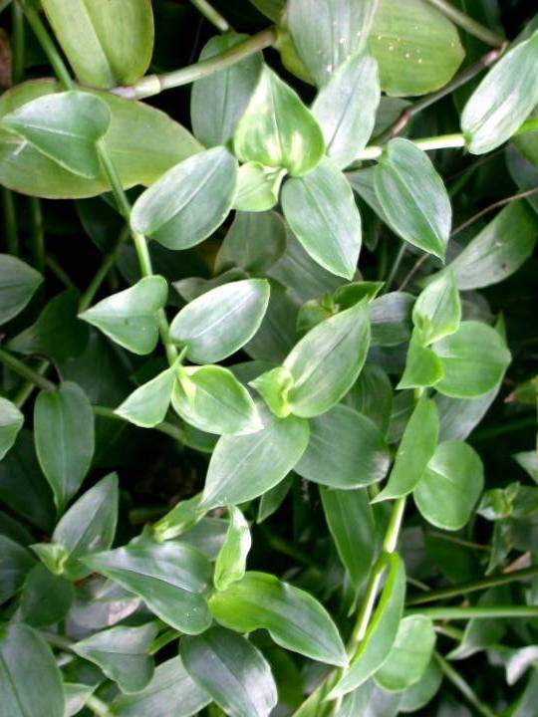
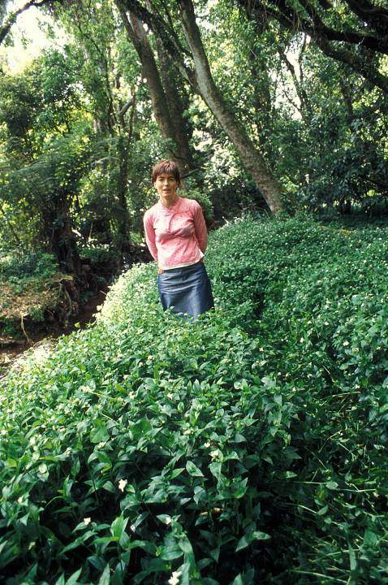
Tradescantia
(Tradescantia fluminensis)

Slide 2
Tradescantia
(Tradescantia fluminensis)
Native to South America
A serious weed in a number of places around the world including New Zealand, Australia and the USA.

Slide 3
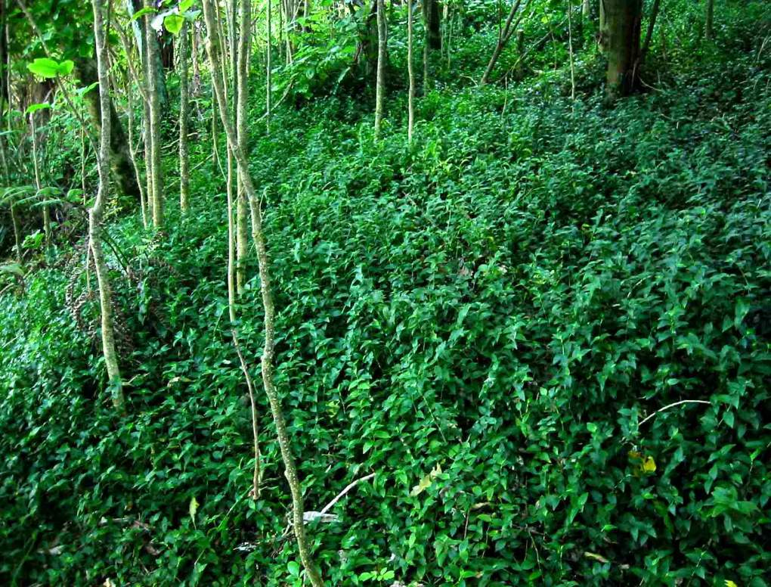

Slide 4
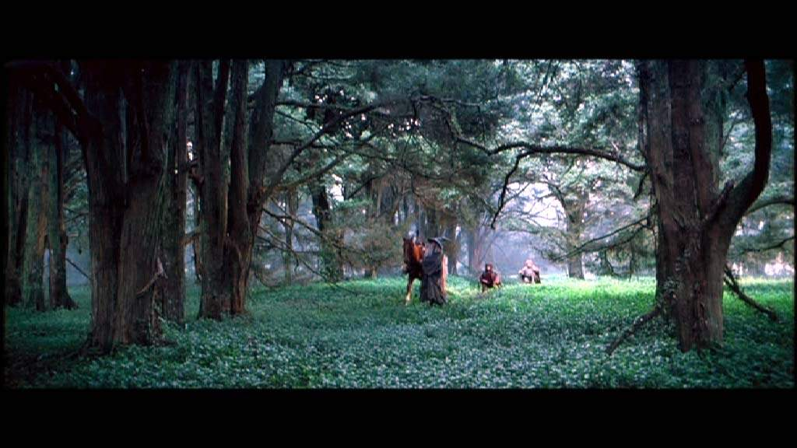
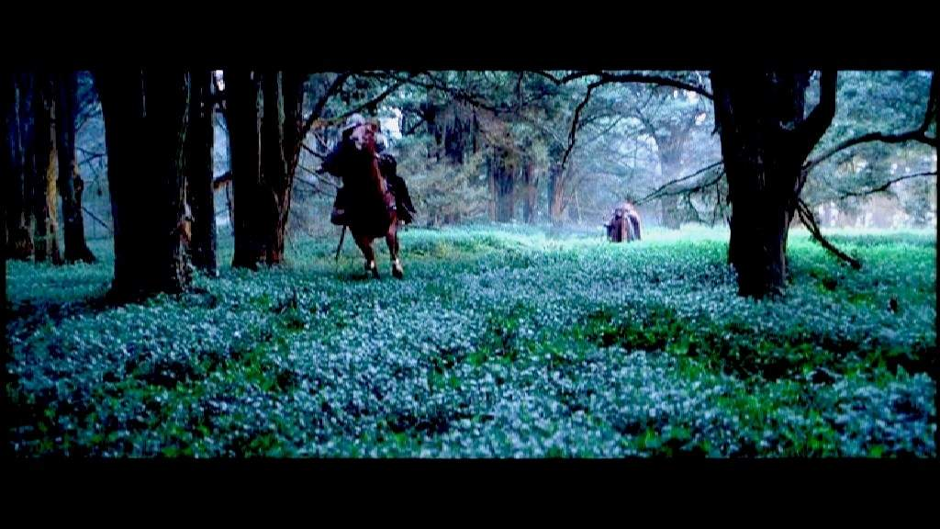
.......but it can also earn valuable overseas dollars!

Slide 5
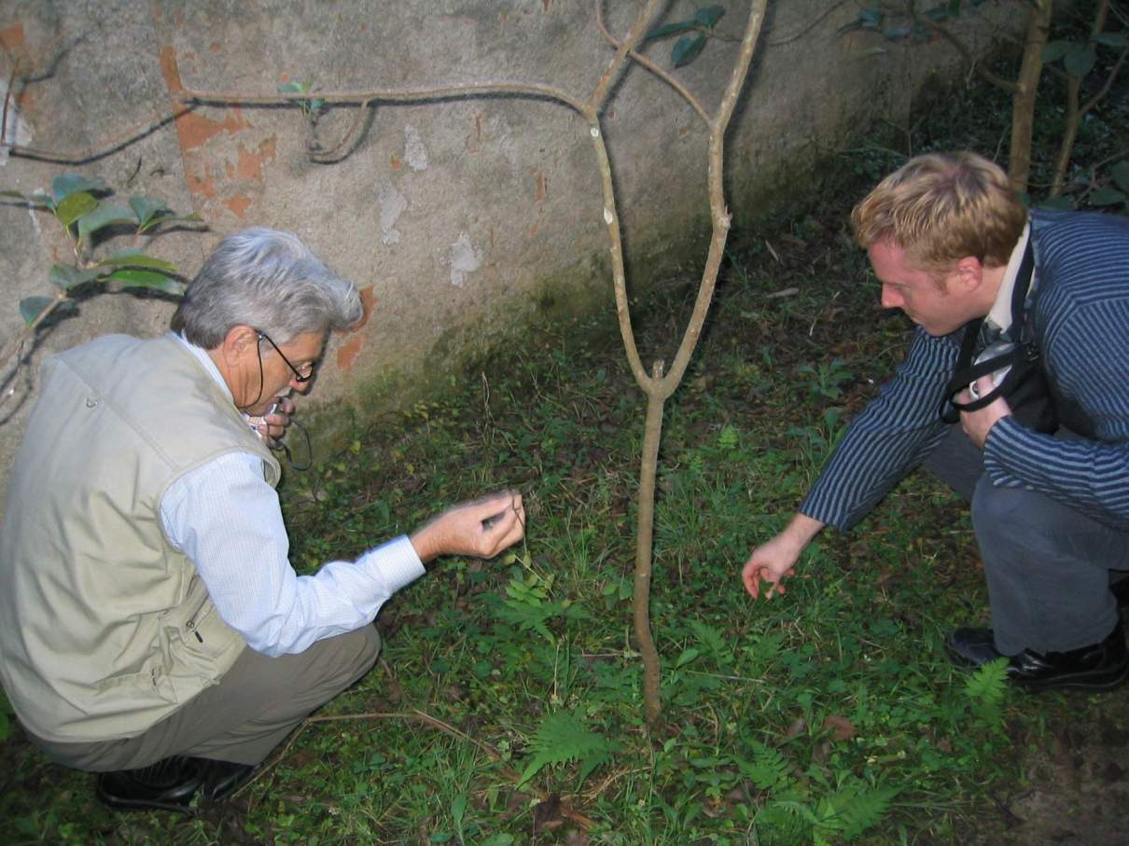

Slide 6
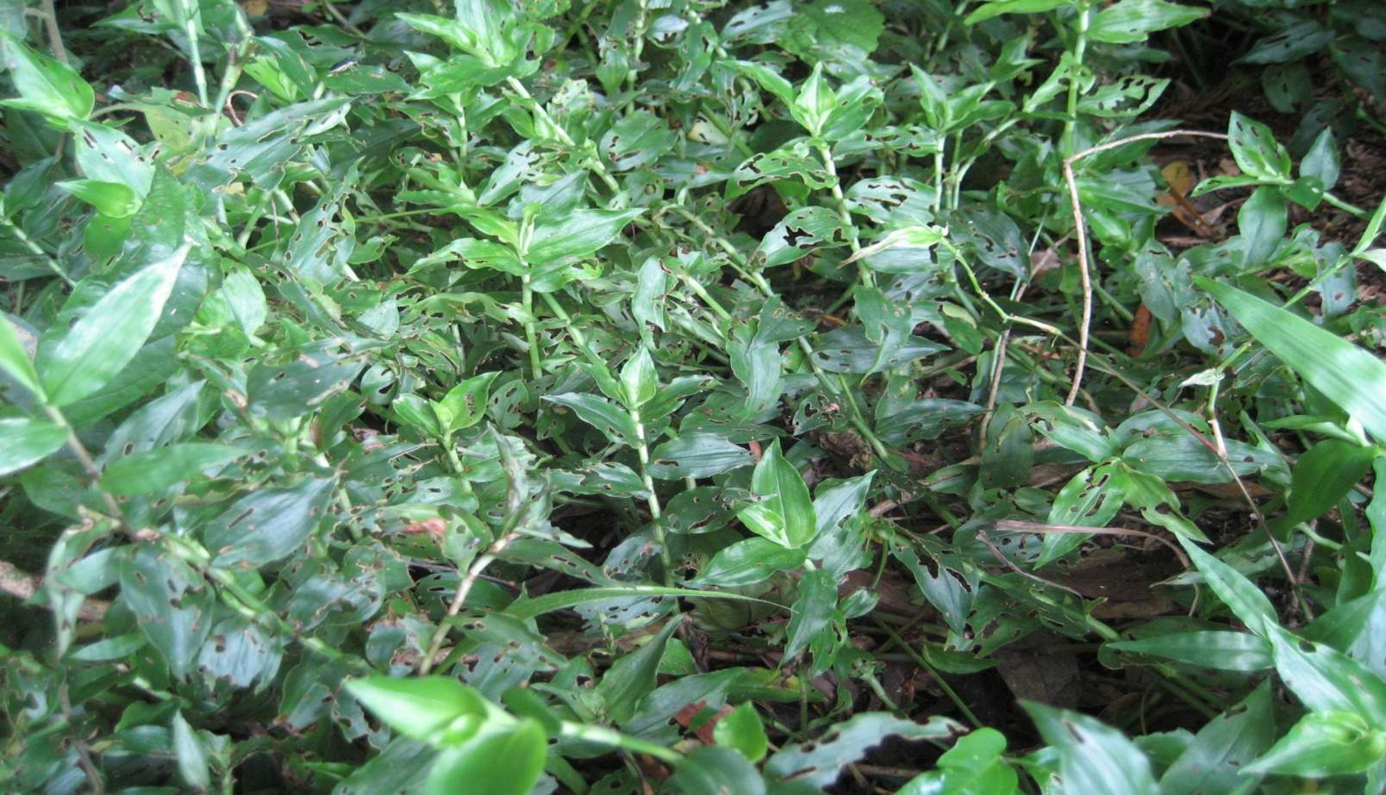
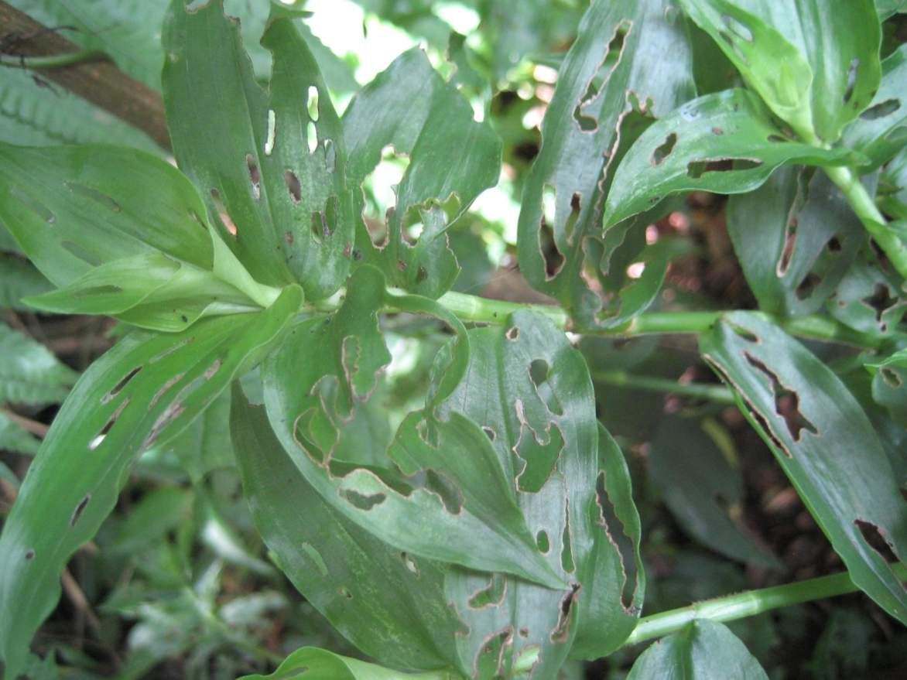
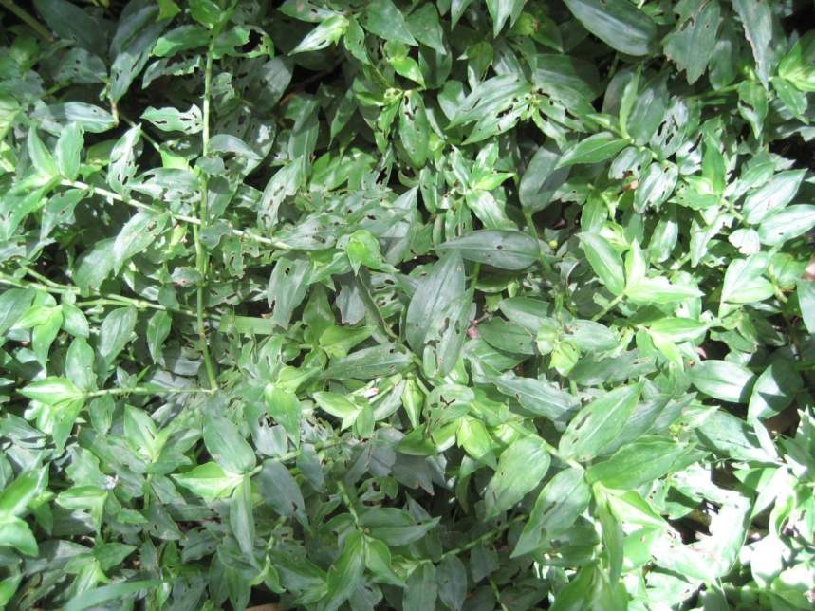
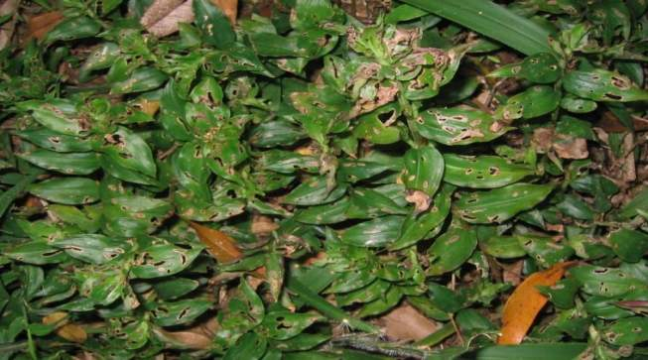
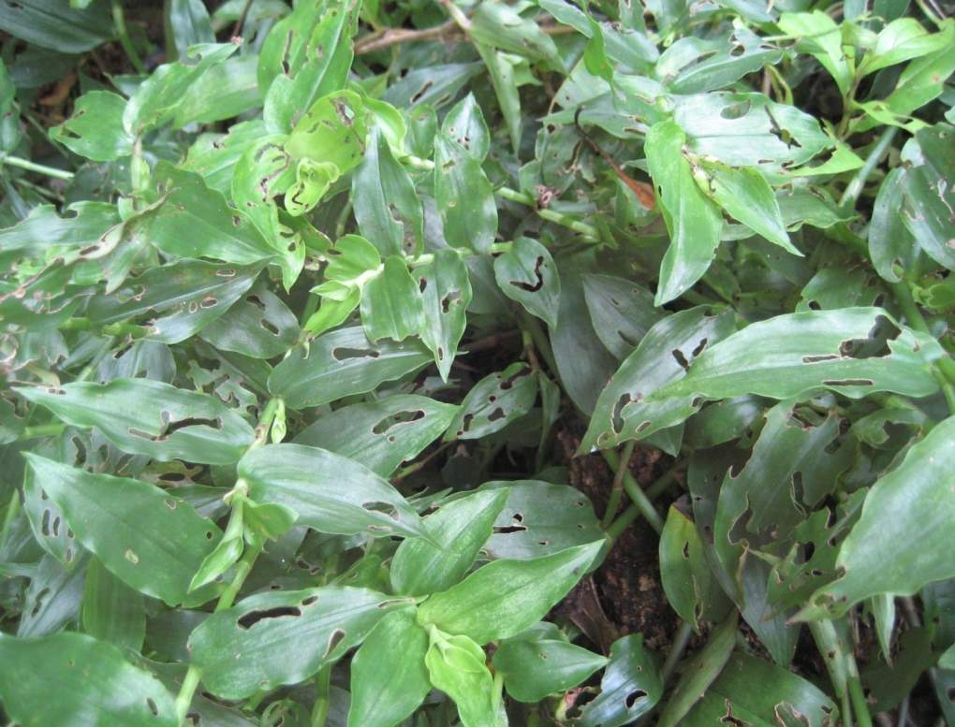
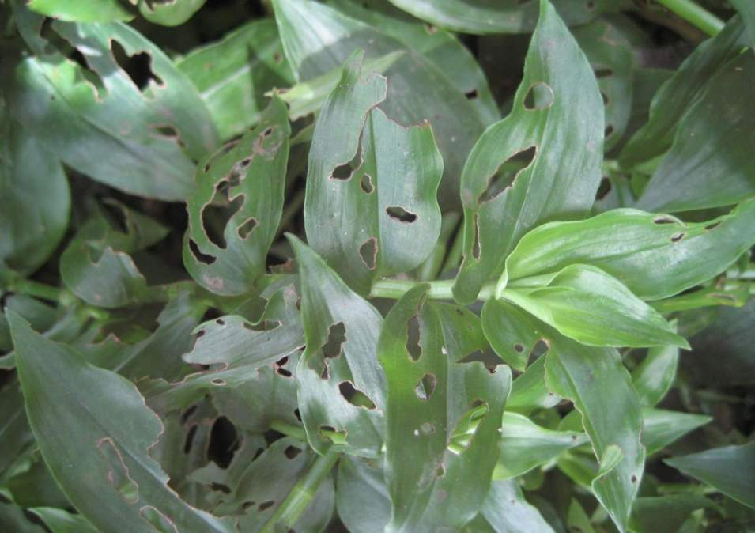
Photo of Miserable-looking Plant
Photo from South America
Beetle damaged Tradescantia in Brazil

Slide 7
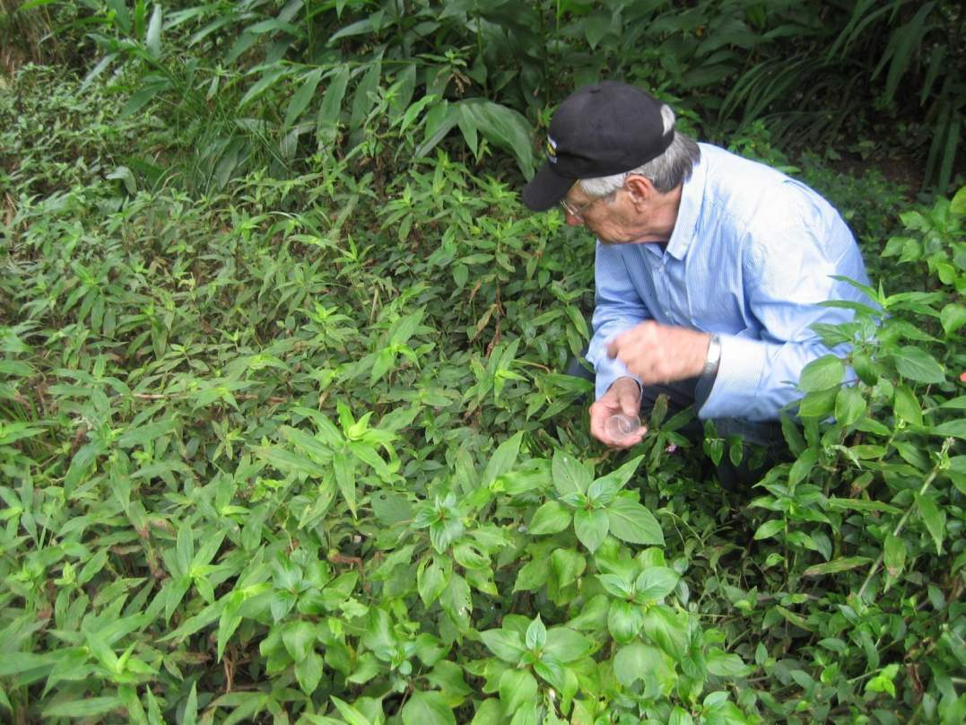
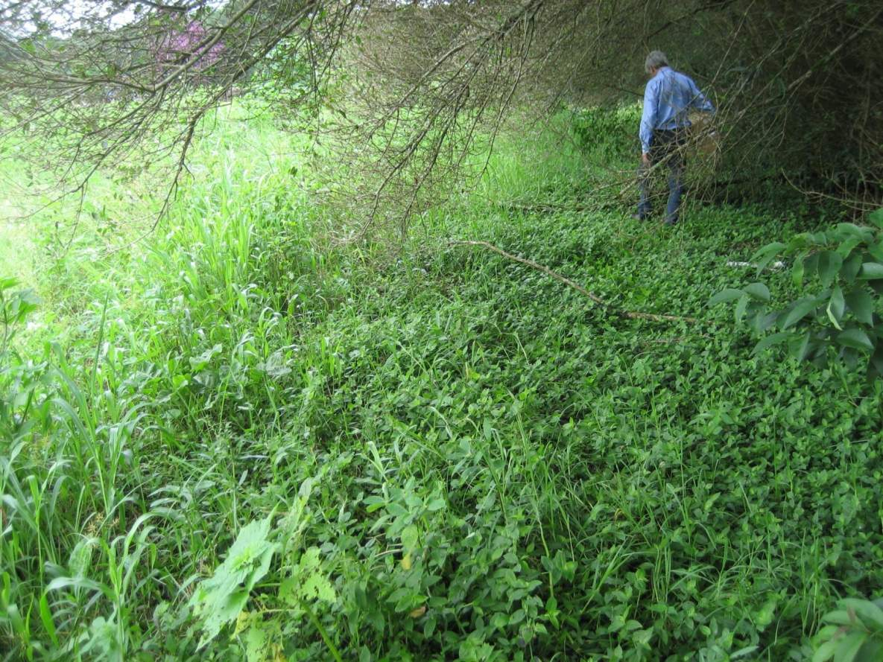
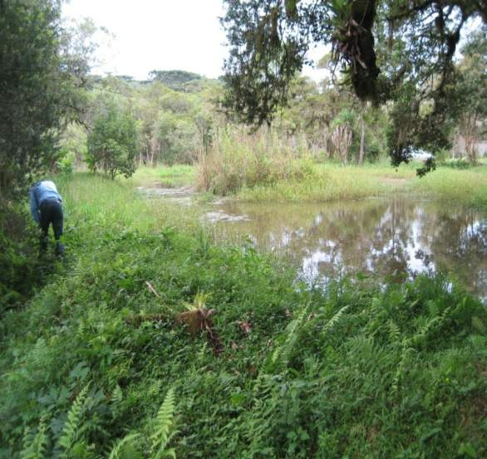
Surveys for potential biocontrol agents began in Brazil in 2005

Slide 8
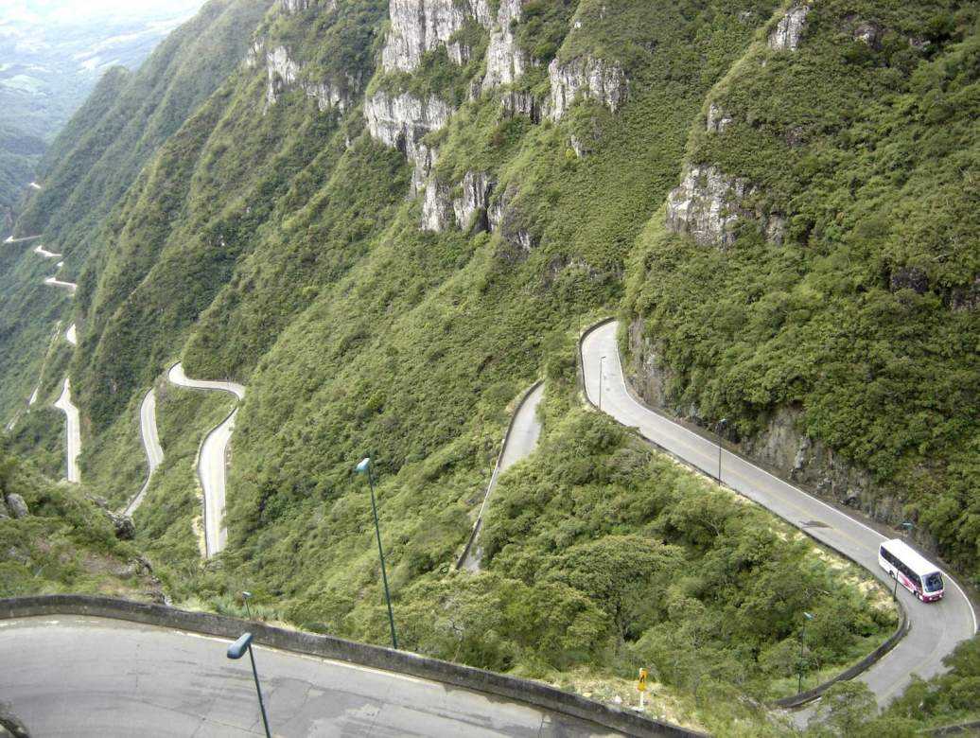
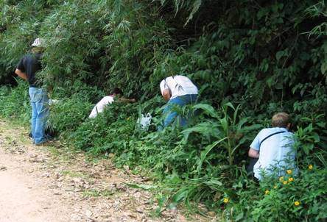
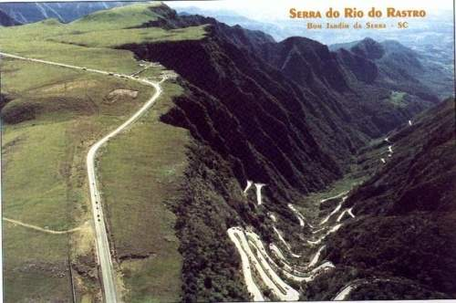
Tradescantia grows best on the slopes of the Brazilian Highlands plateau at altitudes between 600 – 900 m

Slide 9
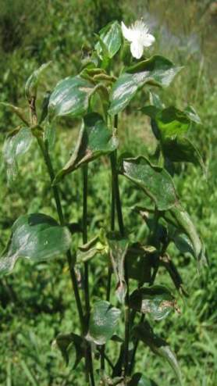
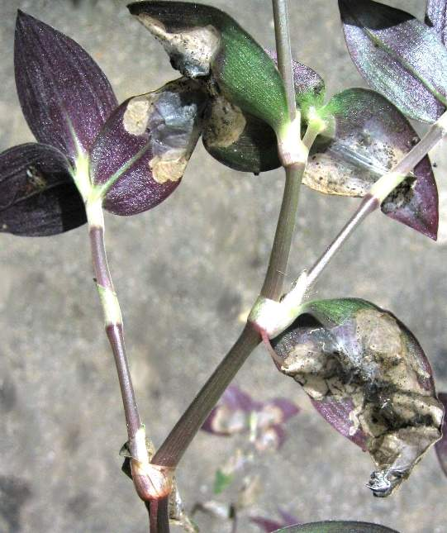
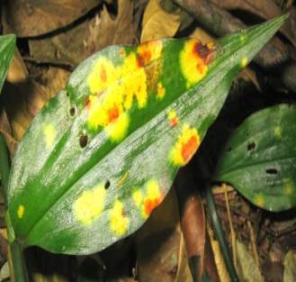
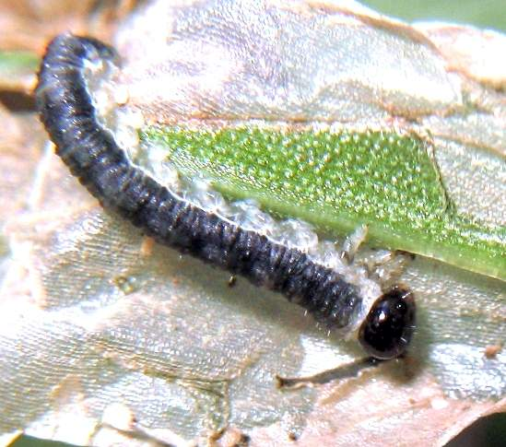
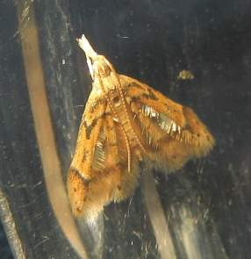
Surveys identified a rich natural enemy biota including herbivorous insects and plant pathogens.
yellow leaf spot fungus
Thrips
Sawfly
Leaf mining moth

Slide 10
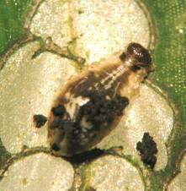
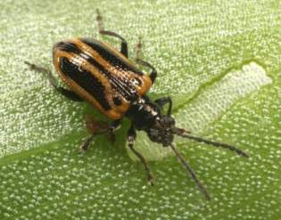
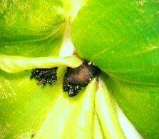
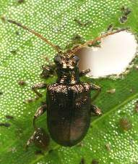
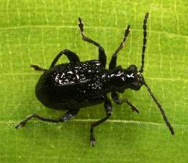
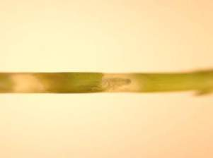
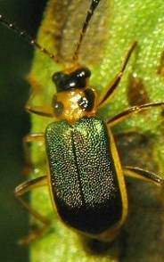
Neolema abbreviata – “stripy”
Neolema ogloblini
Lema basicostata – “knobbly”
Initial agent selection included 4 beetles with complementary larval feeding methods
Buckibrotica cinctipennis

Slide 11
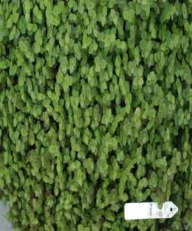
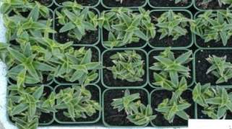
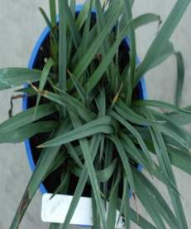
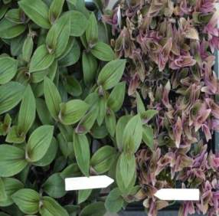
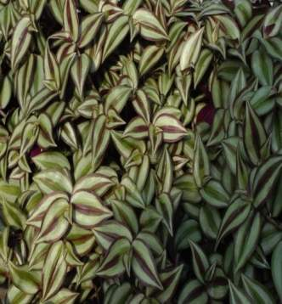
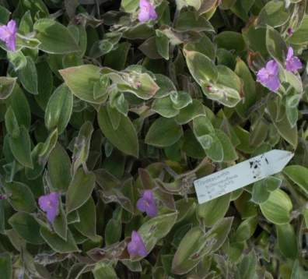
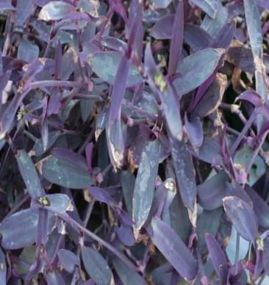
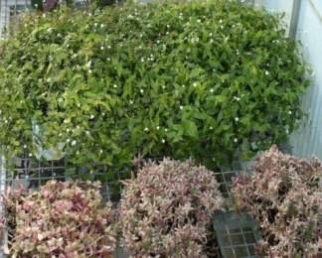
.
Host range testing
Test potential agents against selected plants to determine host range
No New Zealand natives in the family Commelinaceae or the order Commelinales
Nearest NZ relative to Tradescantia fluminensis thought to be nikau palm

Slide 12
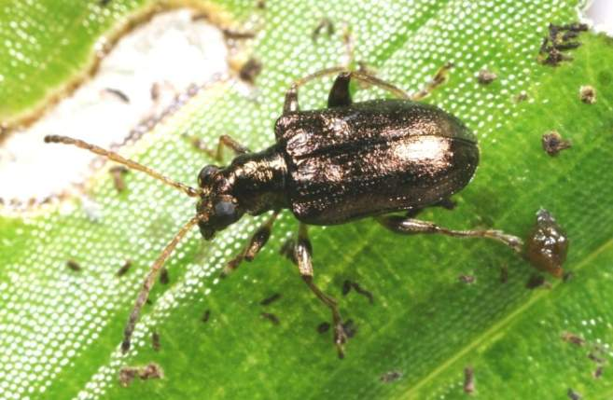
ERMA granted permission to release the first beetle in 2008
the leaf-feeding
Neolema ogloblini

Slide 13
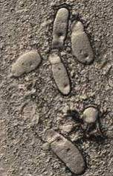
Gregarines discovered
N. ogloblini was affected by a gregarine gut parasite
Little known sporozoan protozoan
Although a common life form little work has been undertaken on gregarines
We cannot release diseased organisms
  putting at risk native beetle species
  N. ogloblini debilitated reducing its impact as a biocontrol agent

Slide 14
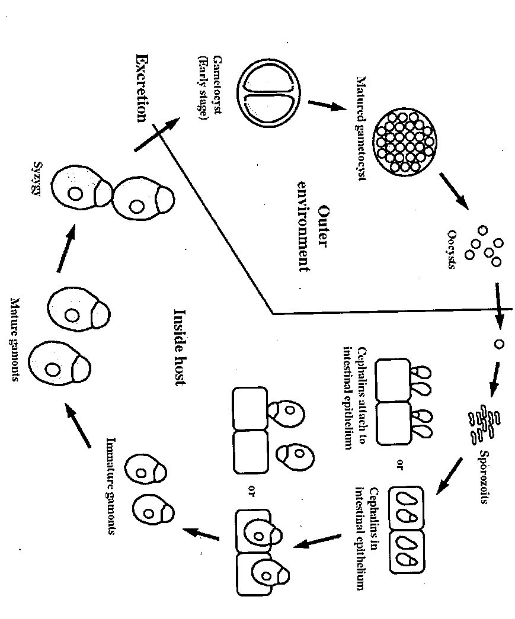
General life cycle of gregarines

Slide 15
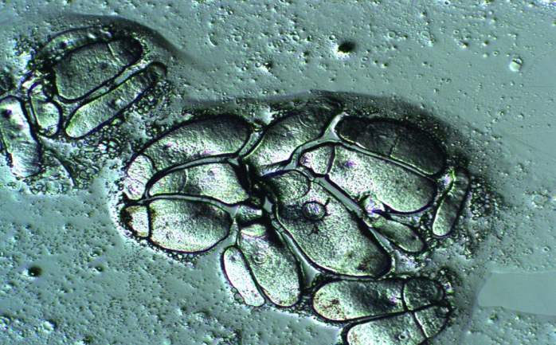
Removal of gregarines from
N. ogloblini populations
Heavily infected rearing lines culled

Slide 16
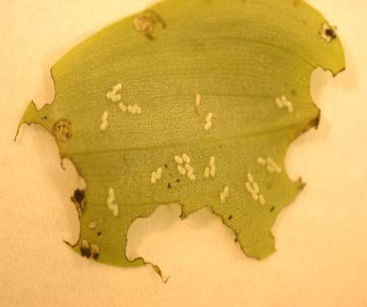
Removal of gregarines from
N. ogloblini populations
Egg surface sterilisation
  Washing eggs in bleach (sodium hypochlorite) solution

Slide 17
Removal of gregarines from
N. ogloblini populations
Egg surface sterilisation
  Washing eggs in bleach (sodium hypochlorite) solution
Significant reduction in gregarine numbers
– however they persisted

Slide 18
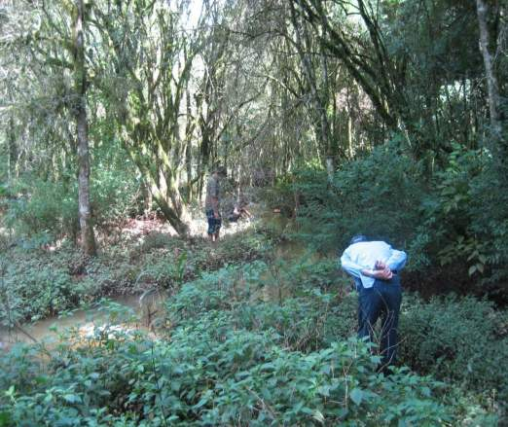
Removal of gregarines from
N. ogloblini populations
  Re collection of beetles from gregarine free field sites

Slide 19
Removal of gregarines from
N. ogloblini populations
  Re collection of beetles from gregarine free field sites
Combined with importing into containment only surface sterilised eggs

Slide 20
Removal of gregarines from
N. ogloblini populations
  Re collection of beetles from gregarine free field sites
Combined with importing into containment only surface sterilised eggs
Gregarines persisted

Slide 21
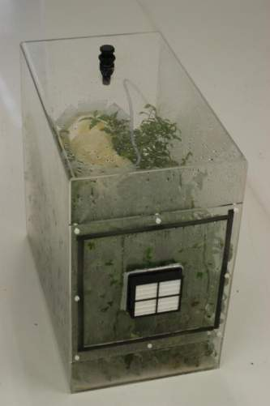
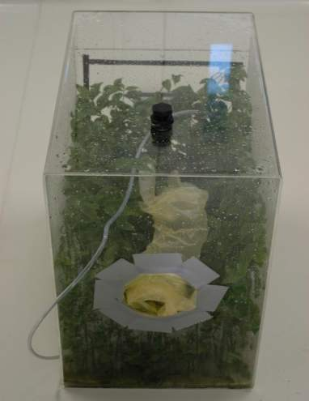
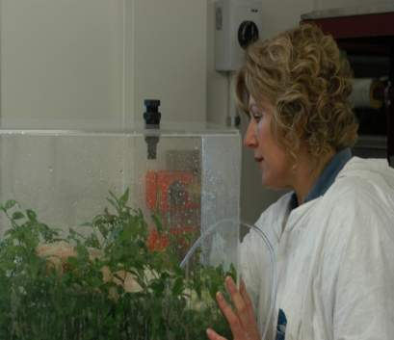
HEPA filtered rearing box
Removal of gregarines from
N. ogloblini populations
  Increasing hygiene standards

Slide 22
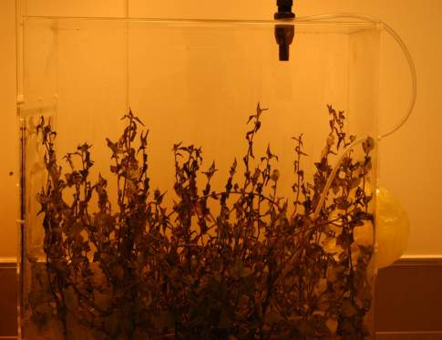
Removal of gregarines from
N. ogloblini populations
  Christchurch earthquake September 2010
    Heat treating beetles beneficial?????

Slide 23
Removal of gregarines from
N. ogloblini populations
  Line rearing - individual eggs to adults

Slide 24

Parent colony
Line rearing Neolema ogloblini

Slide 25
Parent colony
Line rearing Neolema ogloblini
Individual female

Slide 26
Parent colony
Line rearing Neolema ogloblini
Individual female

Slide 27
Parent colony
Line rearing Neolema ogloblini
F1
Individual egg to adult
Individual female

Slide 28
Parent colony
Line rearing Neolema ogloblini
F1
Individual egg to adult
Individual female

Slide 29
Parent colony
Line rearing Neolema ogloblini
F1
Individual egg to adult
F2
Individual egg to adult
Individual female

Slide 30
Parent colony
Line rearing Neolema ogloblini
F1
Individual egg to adult
F2
Individual egg to adult
F3
Individual egg to adult
Individual female

Slide 31
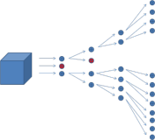

Line rearing Neolema ogloblini

Slide 32
Line rearing Neolema ogloblini
released

Slide 33

Elimination of gregarines
Removing gregarines from the N. ogloblini culture proved difficult delaying release for 2 years
But we succeeded with 3 successive generations disease free

Slide 34
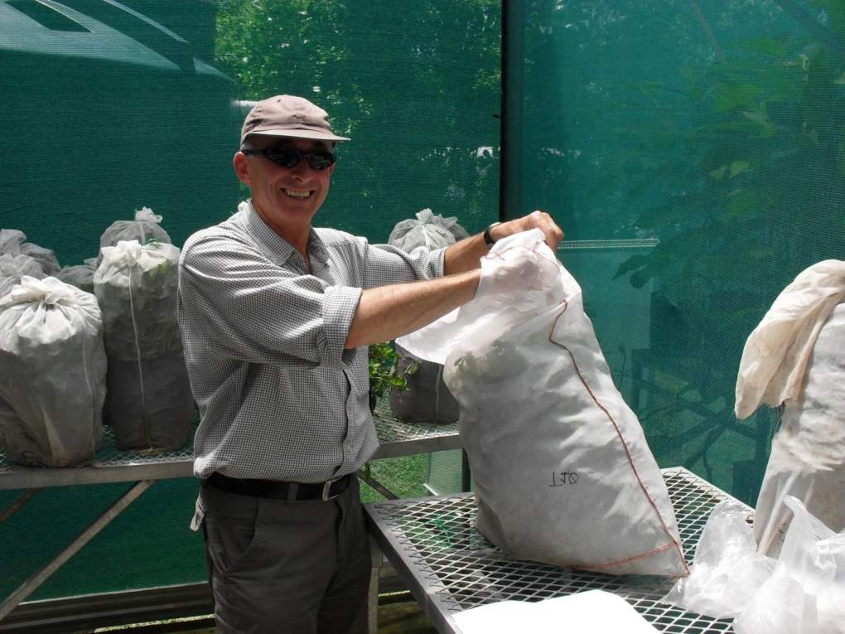

Slide 35


Slide 36
Neolema ogloblini
2,400 adults released at 8 sites around the North Island

Slide 37


Slide 38


Slide 39


Slide 40


Slide 41


Slide 42
A generation in about 8 weeks in warm temperatures
Should get through 3 generations per year

Slide 43
Future of other agents

Slide 44


Auckland Council has recently applied to ERMA for permission to release two further tradescantia beetles
We hope to have a decision by November
Lema basicostata
(stem borer)
Neolema abbreviata
(tip feeder)

Slide 45



yellow leaf spot fungus Kordyana tradescantae

Slide 46

yellow leaf spot fungus
Our collaborators in Brazil have finished host-range testing Kordyana confirming it to be specific to T. fluminensis.
Further work needed on developing a viable inoculum to ship to New Zealand.
Application to ERMA for release this year.

Slide 47
END

