Slide 1
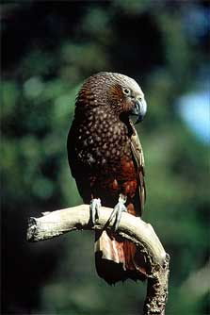
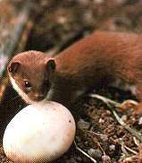
Wide Scale Predator Control: The Hawke’s Bay Project Al Glen & Wendy Ruscoe
Landcare Research
Hawkes Bay Regional Council
Department of Conservation
EcoEd
Volunteer / Iwi groups
Robertson Foundation

Slide 2
Objectives
Identify critical habitat / regionally important sites
Prioritise native species that will benefit from predator control
Assess predator control options with deliverable outcomes
Develop a Project Strategy
Support the local community to set and achieve biodiversity protection goals
Notes:
- Overall aim to assess the feasibility and effectiveness of controlling predators to protect biodiversity over a wide area in Hawke’s Bay

Slide 3
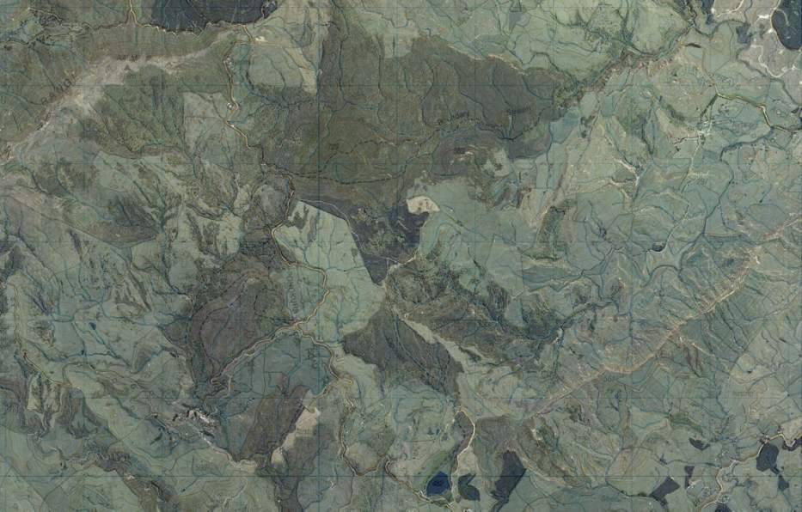
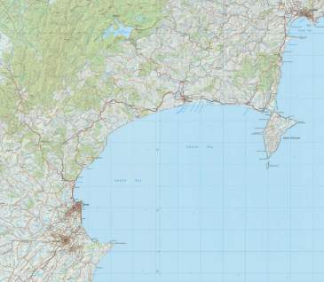
Regionally important site: Maungaharuru Area
Hawkes Bay Conservation Action Plan, DOCDM-479758
Notes:
- DOC recently ranked areas of biodiversity value in Hawke’s Bay. Five high priority sites were identified within the conservancy including the Maungaharuru area
- Also has a strong community group focused on environmental issues

Slide 4
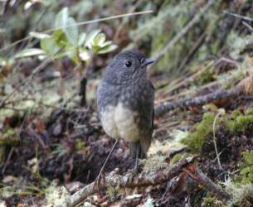
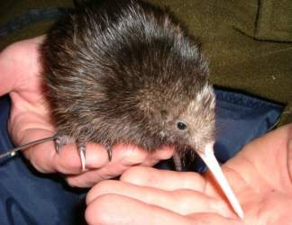
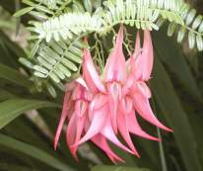
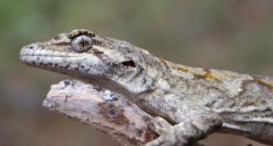
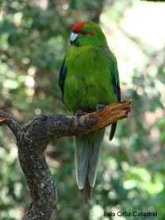
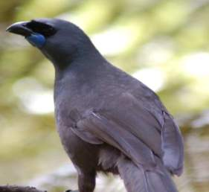
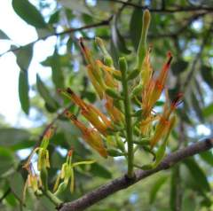
Regionally important iconic species
Notes:
kaka, kiwi, robin, kakariki and kokako, as well as kakabeak, mistletoe and herbal remedy plants of cultural significance

Slide 5
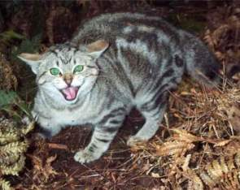
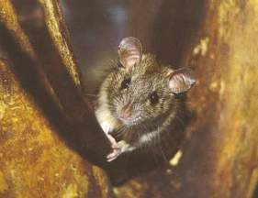
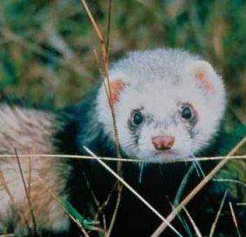
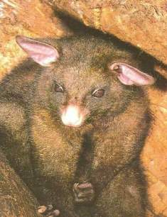
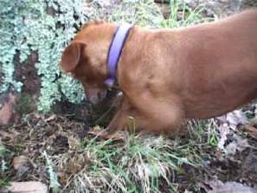
Threats: Predatory animals
Notes:
main threat to the birds is most likely predation by ferrets, cats, dogs, stoats and rats

Slide 6
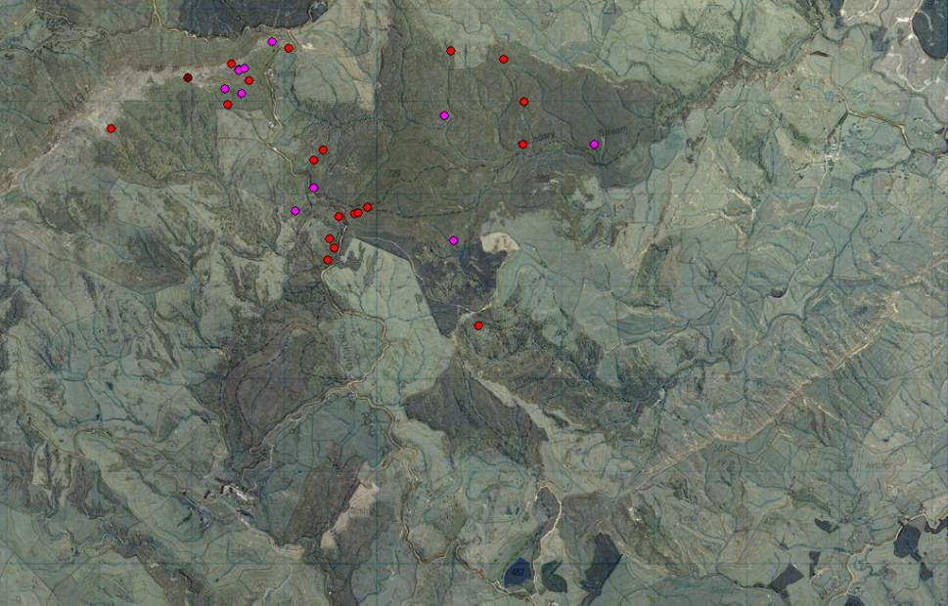
Kiwi kills

Slide 7
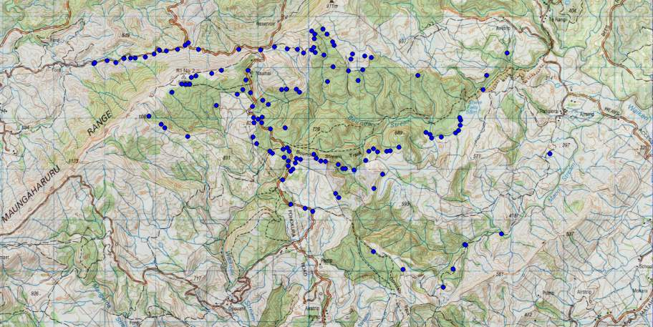
Boundary Stream Mainland Island Predator Trapping
Kahori Nakagawa, DOC
Ferret catch locations between 1996 and January 2011
Ferret catches 1-2 3-4 5-7 8+

Slide 8
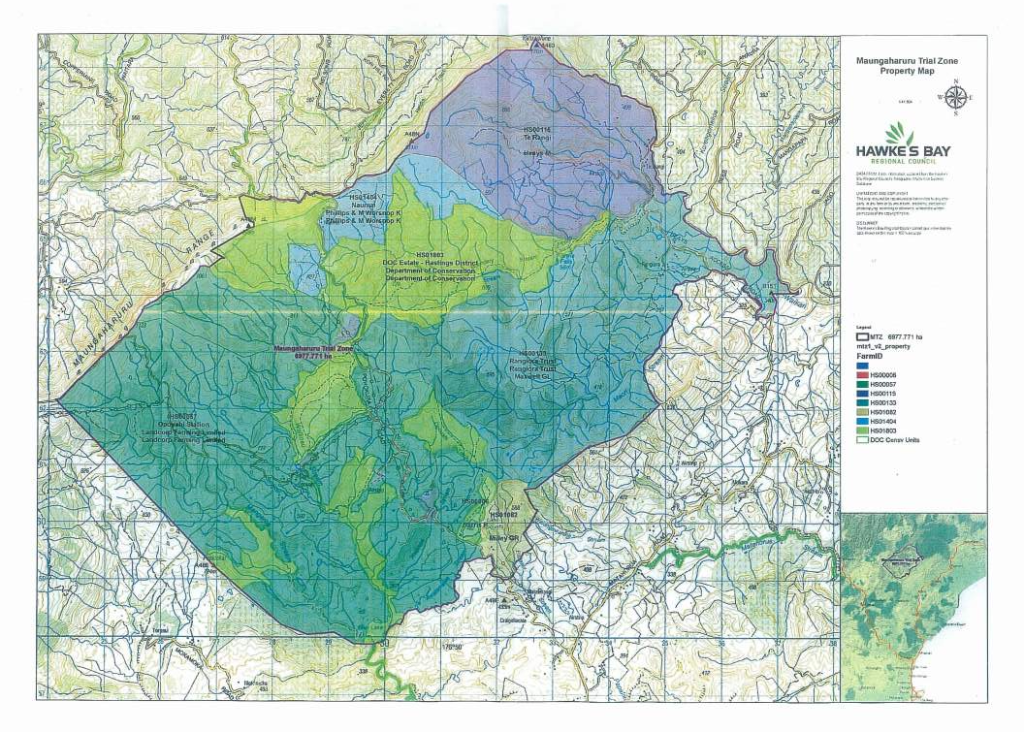
Proposed Project Area
Notes:
- project area ~8000 ha
- 25% public conservation estate, surrounded by a mixture of privately owned pasture and scrubland

Slide 9
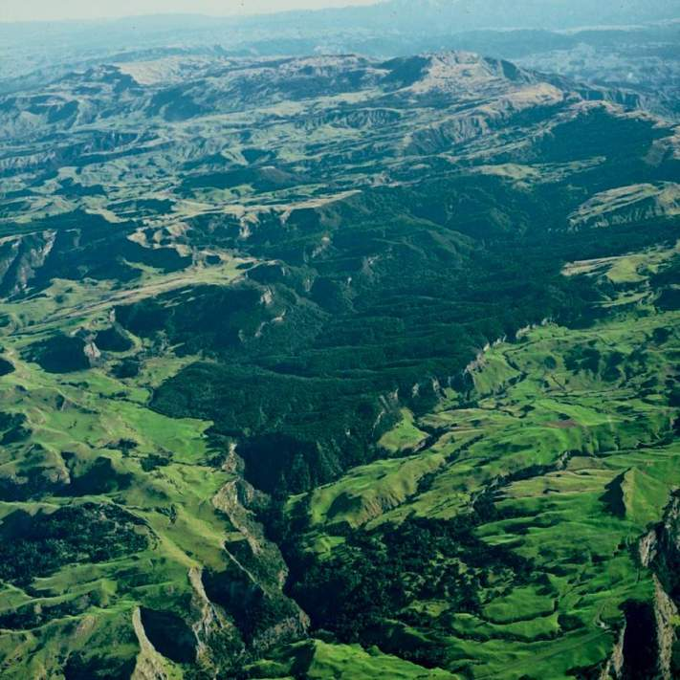

Slide 10
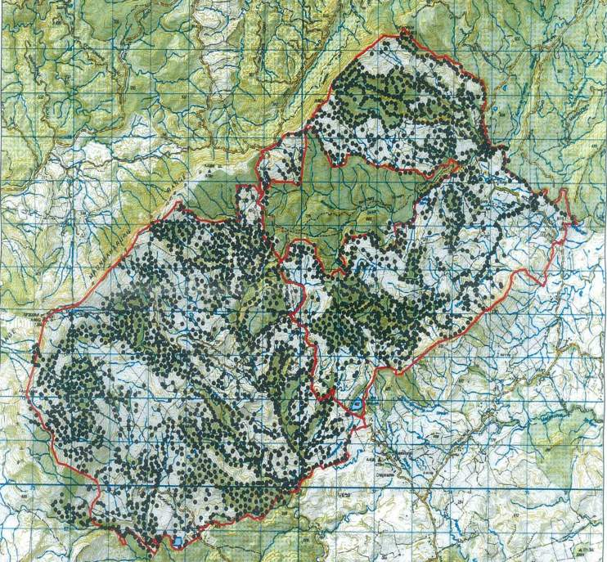
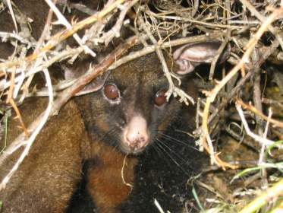
Bait stations for ground control of possums (AHB)
Notes:
- Potential to use possum bait stations for predator baits

Slide 11
Predator control options
Traps:
DOC200s for stoats and rats in forest scrub areas
DOC250, Belisle cat traps and chimney tunnels for ferrets and cats in wider landscape
Leg-hold traps?
Self-setting traps?
Baits
Diphacinone in AHB bait stations for rats
PAPP for stoats (cats) – use in DOC220/250 and chimney tunnels. Restricted use
Notes:
and can be used by volunteers
trapping will hopefully start by summer 2011/12

Slide 12
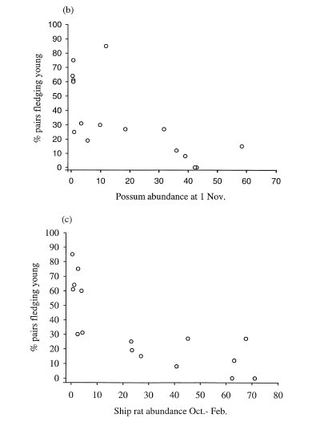
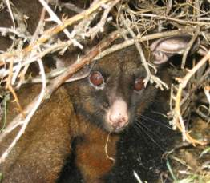
Management Plan
Innes et al. 1999
Most efficient tools and strategies
Target densities for pests (kokako example)
Monitoring effectiveness (historical data)
Pest monitoring (i.e. rabbit counts by HBRC, DOC)
Bird monitoring in DOC areas
Pest and native biota monitoring (Landcare Research)
Community participation
Addressing community concerns
Rabbit response to predator control
Notes:
- Recommend possum RTC <1% and rat tracking tunnel index <5% for kokako

Slide 13
No Control
Predator + Rabbit Control
Predator Control
This provides an opportunity to test whether doing both predator and rabbit control imparts additional benefit to biodiversity. Historical data (BACI)

Slide 14
Monitoring the benefits
Indicator species:
are relevant to your monitoring questions
are likely to show change within a useful timeframe
can be measured easily and precisely
Tracking tunnels - mustelids and rodents
Chew cards – possums and rats
Bird counts – calls, radio-tracking, recording devices?
Cameras
Weta houses and tracking tunnels
Pitfall traps
Artificial covers – invertebrates and lizards
Seedfall traps
Notes:
This is where LCR comes in: monitoring the benefits

Slide 15
Notes:
kaka, kiwi, robin, kakariki and kereru, as well as kakabeak, mistletoe and herbal remedy plants of cultural significance
main threat to the birds is most likely predation by ferrets, cats, dogs, stoats and rats

