Slide 1
Overview and Status of the Beating Weeds Project
Simon Fowler, Landcare Research

Slide 2
Beating Weeds Project
Improved management of, in particular, environmental weeds $1.78m/yr (inc GST)
AgR major collaborator ($0.68m/y); smaller contracts to SCION/Uni’s
Integrated research with end-users esp. DOC
Aligned with Undermining Weeds (AgR)
Complements operational research funded by Regional Councils, DOC, MAF, NZ Army etc (much through “Biocontrol Collective”)

Slide 3
Beating Weeds – objectives
1. Prioritisation: weed prioritisation models; predicting good biocontrol targets; national weeds distribution database
2. Improved tools: cost effectiveness, efficacy and non-target impacts of biological and chemical weed control
3. Biodiversity and ecosystem benefits: optimising med/long term gains from environmental weed control

Slide 4
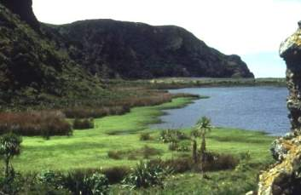
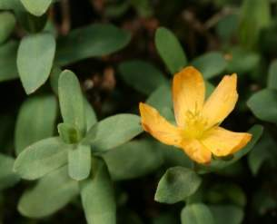
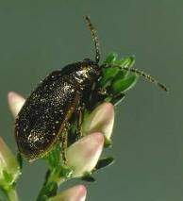
Highlights
Predicting good biocontrol targets – Quentin (aquatic weeds/workshop)
Non-target impacts – Ronny (St John’s wort)
Biodiversity benefits of biocontrol – Paul (heather beetle)

Slide 5
Two highlights in more detail
Improving herbicide use against wilding trees
Broom gall mite

Slide 6
Improving herbicide use on wilding trees
One of the most important invasive weed issues in NZ
Biocontrol not currently an option
More cost-effective options for dense infestations and managing outliers in difficult terrain

Slide 7
Better wilding control
Spot treatment of bark
Highly effective - optimal herbicide mix good for all woody species
Minimises non-target damage
Cheaper/faster/less risky than skid-hopping
Scion + Department of Conservation

Slide 8
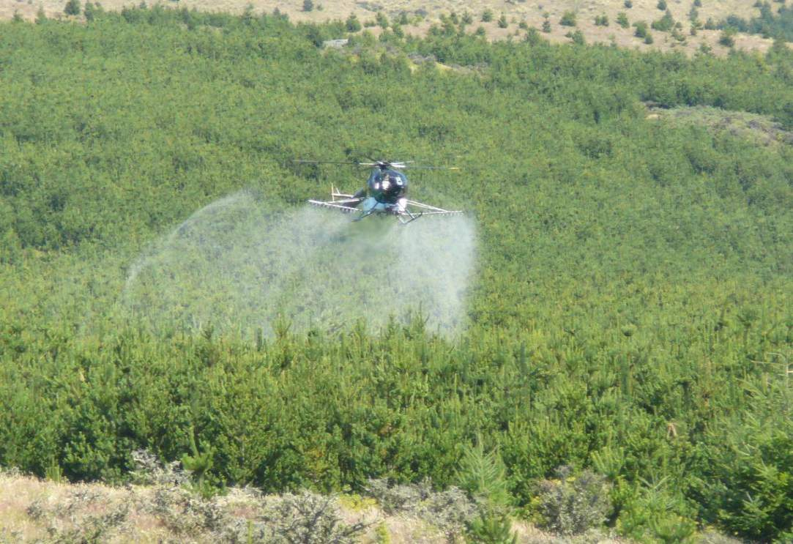
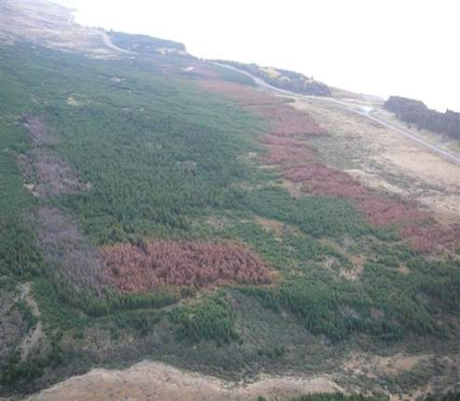
Large scale wilding control
>95% kill in the preliminary trial - more reps/more sites planned
Trialling herbicide mixes to reach 100% kill

Slide 9
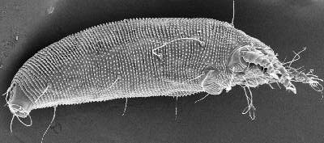
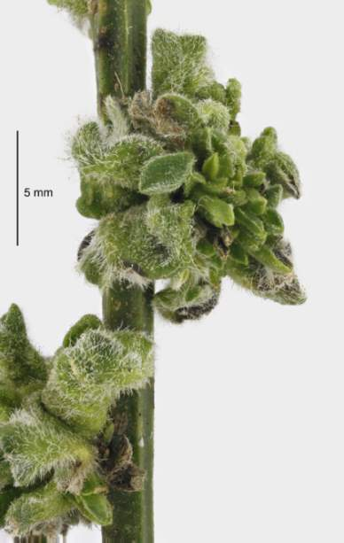
Broom gall mite – what’s going on?
Broom gall mite Aceria genistae introduced in 2008 - inoculated plants already dying
Recent research on mango mite suggests that a plant pathogen causes the galling
Mite vectors the pathogen – together causing rapid plant death

Slide 10
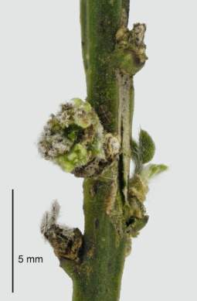
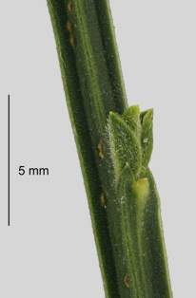
Galls/pathogens – who’s doing what?
Are broom galls caused, in part, by a pathogen?
Could explain occasional small galls prior to the introduction of the gall mite:
Gall without
mites
No gall
Gall
with
mites

Slide 11
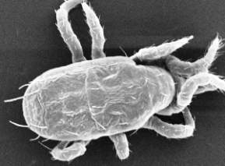
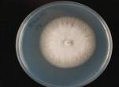
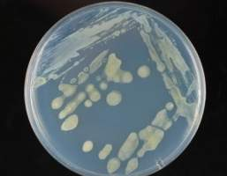
Current research – what’s in broom galls in NZ?
Complex of native predatory and fungus feeding mites
Fungi in 4 genera
Bacteria: a species 98% similar to Pantoea agglomerans (a known gall-forming species) was very common

Slide 12
Current research – what’s on the broom mites?
Microbes are present on the mites

Slide 13
New multi-disciplinary project
Novel combination of acarologists, entomologists, pathologists and ecologists: LCR and international expertise
Should see more of this under new funding structures – less protective ‘silo’ approach
Fascinating science – relevance to biocontrol?
Important to understand how our agents work
Assess/evaluate risks of non-target effects
Future targets – e.g. gall mite on old man’s beard

Slide 14
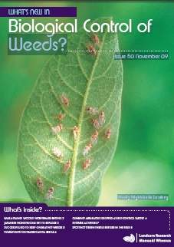
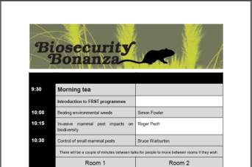
How do we transfer information?
Newsletter: What’s New in Biological Control of weeds
Workshops e.g. “Biosecurity Bonanza”
Website
Workshop issue
http://www.landcareresearch.co.nz/research/biocons/weeds/

