Slide 1
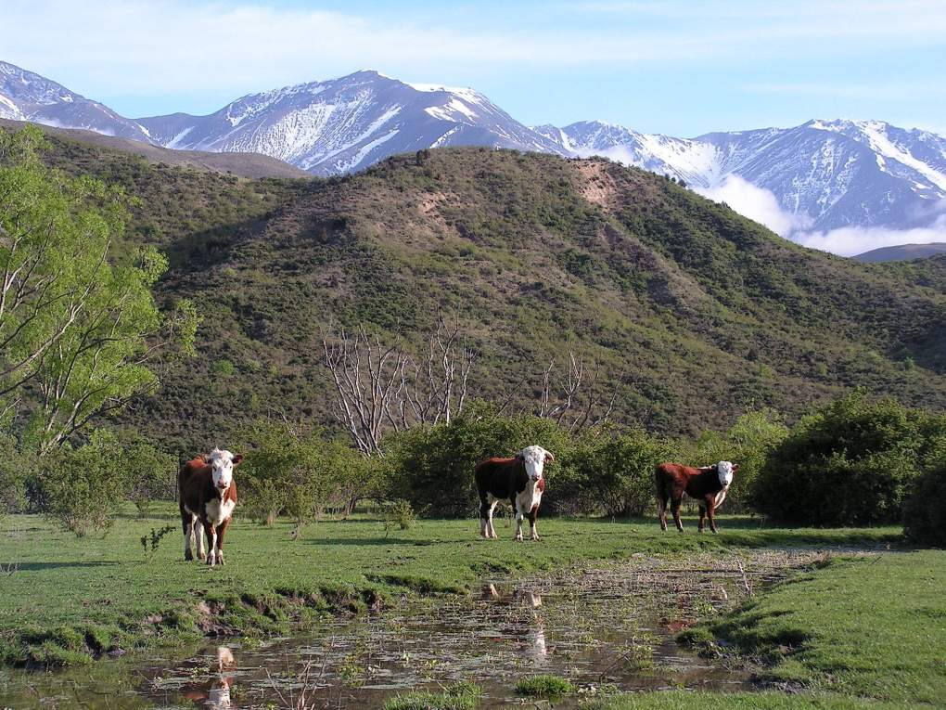
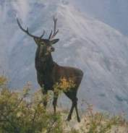
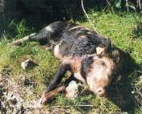
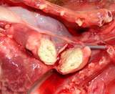
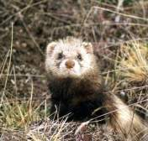
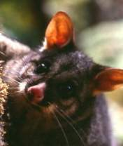
Bovine Tb suppression systems
G Nugent, D. Anderson, A. Gormley,
P. Holland, M. Barron
Landcare Research, P.O. Box 40,
Lincoln, New Zealand

Slide 2
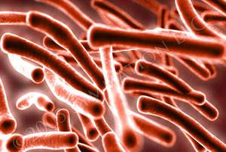
Outline
Progress in reducing TB
Switch from control to eradication
When to stop
Need to ‘prove’ freedom’
Resource allocation problem
Control vs surveillance conundrum
Implications for TB management
‘Proof of concept’ eradication case study

Slide 3
Progress in reducing TB
10 mill ha with TB-infected wildlife
But >95% reduction in TB-infected herds since 1994
Just 69 Infected herds in March 2011

Slide 4
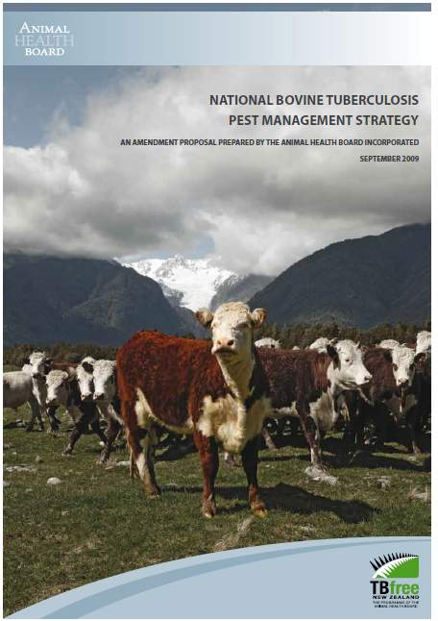
New aims
Success has driven a major change in NPMS-TB goals
From: Meeting OIE ‘TB freedom’ requirements
Infected Herd Period Prevalence ≤ 0.2%
To: Achieving true eradication of TB
- Domestic and wild animal populations become and remain biologically free of M bovis infection

Slide 5
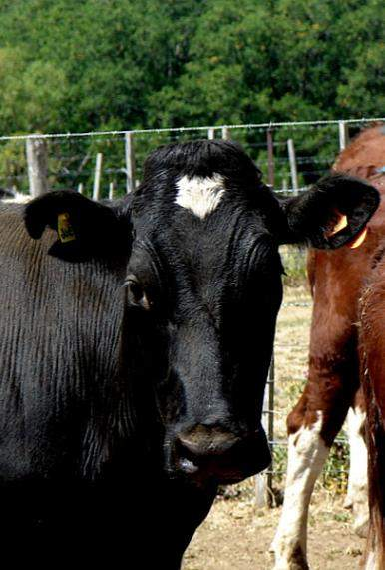
New imperative
Direct economic loss from TB now small (< $1m p.a.)
Not economically sensible to spend $84m p.a. to save such a small amount
High risk that NPMS support may wane before TB fully eradicated?
=> Crucial that eradication is achieved as swiftly and as cheaply as possible

Slide 6
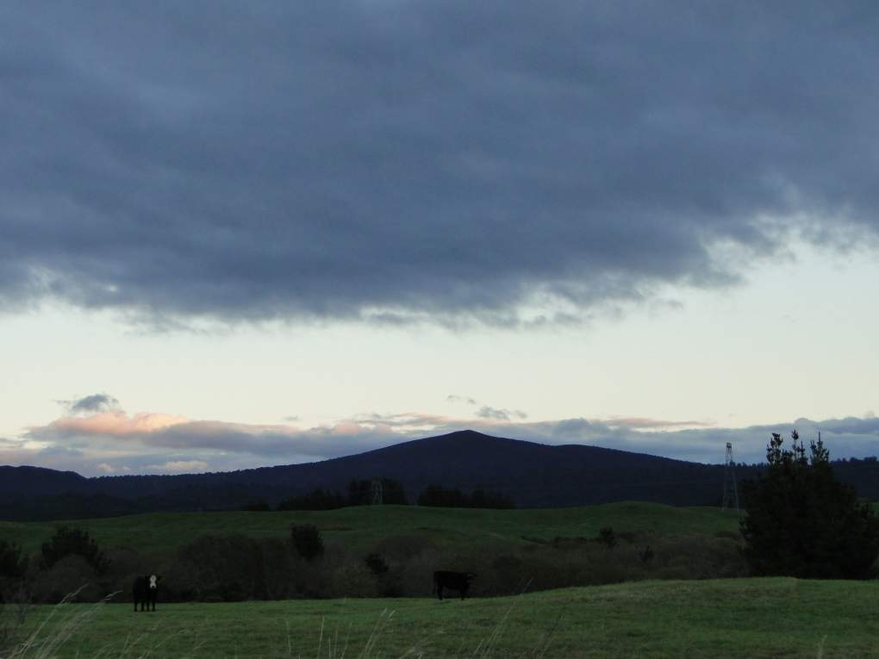
Specific Eradication Objective
Eradicate TB from wild animals over 2.5 m ha by 2026
25% of wildlife-TB area
Must quickly ‘prove’ that TB can be eradicated from large forest tract with a long history of infection
Two ‘Proof of Concept’ areas designated (Hokonui (SI) and Hauhungaroa (NI) Ranges
By 2015/16:
Stakeholders want significant measurable progress towards achieving eradication, especially in the Proof of Concept areas, and efficiencies in vector control

Slide 7
Proof of Freedom Model
LR has developed a quantitative framework for calculating the probability of TB eradication
Pest Control History
Wildlife Surveillance
Livestock Surveillance
Spatial Possum Model
prior
Possum/Sentinel Surveillance Model
Livestock Surveillance Model
Independent evidence
Possums P(Free)
Livestock P(Free)
Area-wide P(Free)

Slide 8
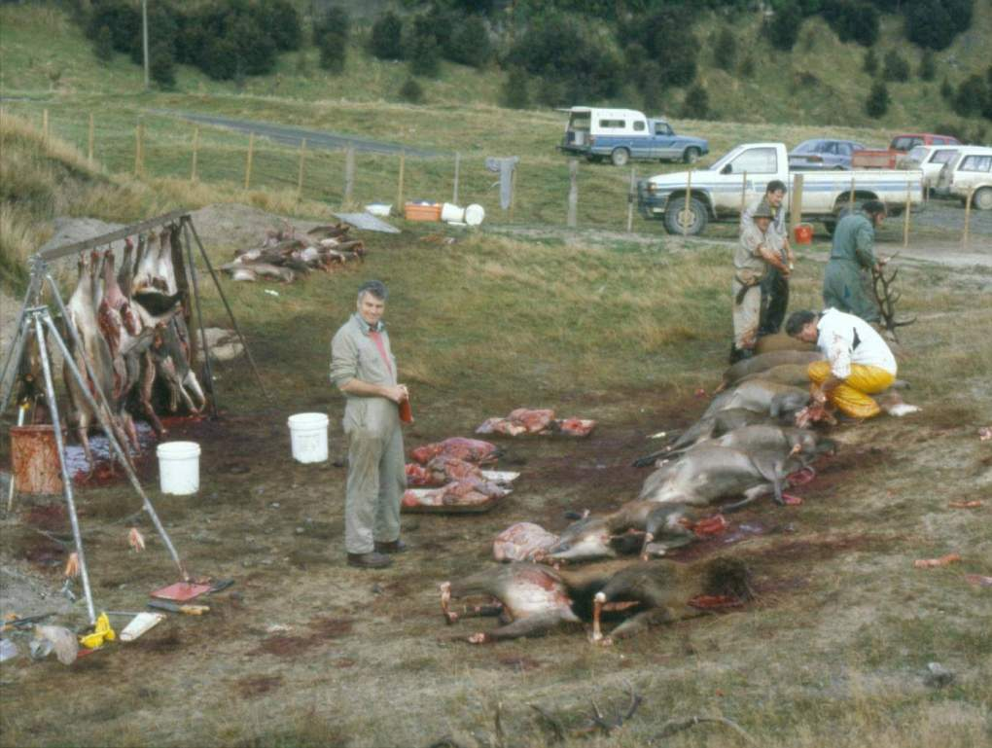
Key Question
When it is safe to stop vector control (and TB testing)
But ‘proving’ Tb is gone, with high confidence, requires expensive surveillance
Key question is when to shift funding from control to surveillance
Too soon, and $$ wasted showing Tb still present
Too late and $$ wasted on unnecessary control

Slide 9
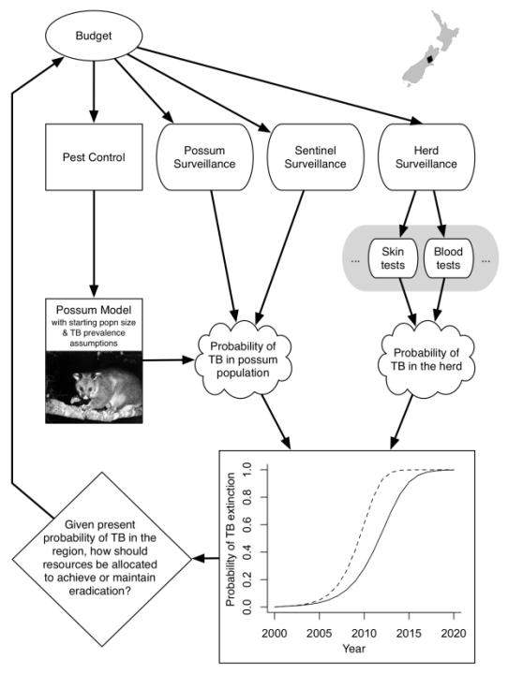
Resource allocation framework
Each activity increases the estimate of TB eradication probability
But surveillance often does not change actual probability

Slide 10
Resource allocation (2)
POF uses multiple information sources
History of control
TB survey of possums
Tb survey of sentinels
Herd testing
Q: Where is funding best spent?

Slide 11
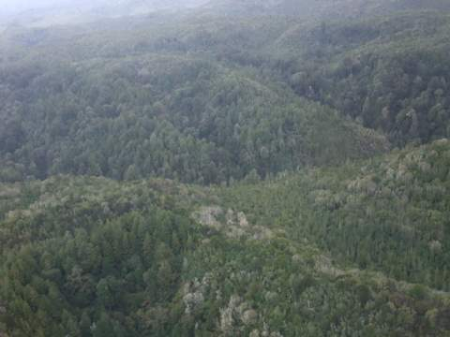
Eradication proof of concept trial Hauhungaroa Ranges (2011-2026)
Compare speed & cost effectiveness of 4 approaches
Standard (conventional broadcast aerial 1080)
trap-catch monitoring, sentinel (pig and deer) Tb survey
Low cost standard (cluster aerial 1080)
trap-catch monitoring, sentinel (pig and deer) Tb survey
Targeted low cost aerial 1080
Low intensity mapping and surveillance of possums
Ground-based detection & mop up
Intensive control & surveillance of possums

Slide 12
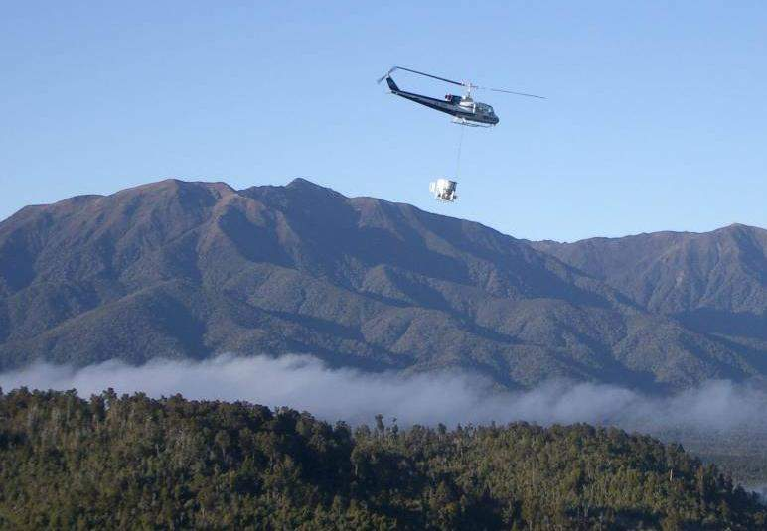
1. Standard broadcast aerial
3-4 aerial operations at about 5-yearly intervals, with possum abundance assessment plus sentinel (deer and pig) surveys of TB prevalence
Likely to be highly effective
Assuming ultra-low RTCI’s (<0.5%), v high predicted probability of eradication from possum model
But relatively little surveillance data (pig and deer sentinel only) to empirically confirm TB absence.
=> can we really believe the model predictions?

Slide 13
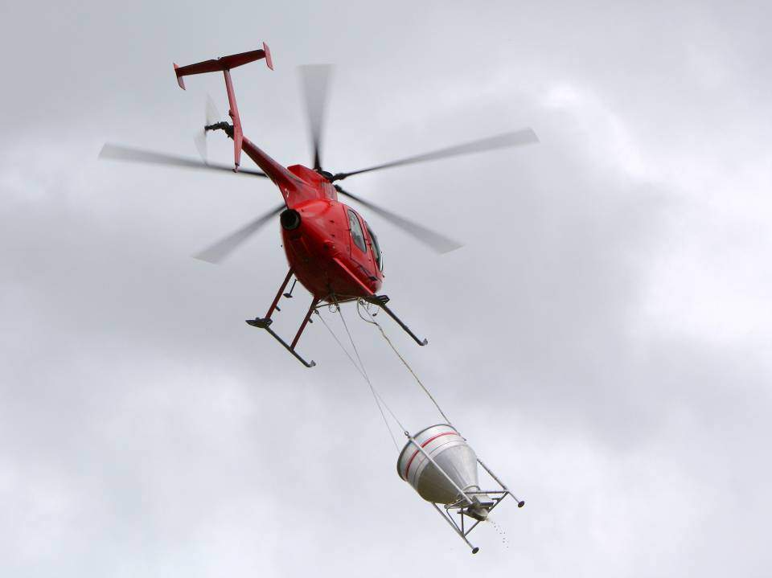
2. Low-cost cluster aerial
3-4 aerial operations at c 5-yr intervals, but low-cost ops after the first one – again w. possum abundance assessment plus sentinel (deer and pig) surveys of TB prevalence
Also likely to be highly effective
Assuming low RTCI’s (<2.0%), still high predicted probability of eradication from possum model
But again relatively little surveillance data (pig and deer sentinel only) to empirically confirm TB absence.
=> Lower cost but less confidence in predictions

Slide 14
Control focussed
options
Options 1 & 2 rely on ‘overkill’ - making sure TB has been eradicated by driving the actual probability of TB persistence to miniscule levels
Expensive and risks failure if control is not complete

Slide 15
Assumptions vs Real World
Model assumes good even control
In reality, there can be gaps in coverage
Famous Hohotaka blackberry patch
Impossible to quantify this risk
=> Need for over-kill or empirical surveillance back-up
1.0
0.8
Predicted
Actual
0.6
TB prevalence
0.4
0.2
0.0
-1
0
1
2
3
4
5
6
7
8
9
Year after maintenance control
Caley P.; Hickling G.J.; Cowan P.E.; Pfeiffer D.U. 1999. Effects of sustained control of brushtail possums on levels of Mycobacterium bovis infection in cattle and brushtail possum populations from Hohotaka, New Zealand. New Zealand Veterinary Journal 47 133-142

Slide 16
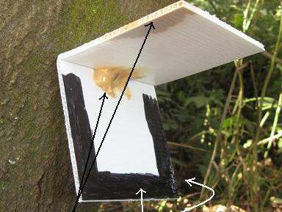
3. Targeted cluster aerial
3-4 aerial operations at c 5-yr intervals, but ultra-low-cost ops after the first one – targeted only at areas with possums
Later ops cover < 50% of area (v low aerial cost)
Targeted used ground-based mapping with chew cards
Still high predicted probability of eradication
Mapping provides more direct possum surveillance data (plus pig and deer sentinel) to empirically confirm TB absence.

Slide 17
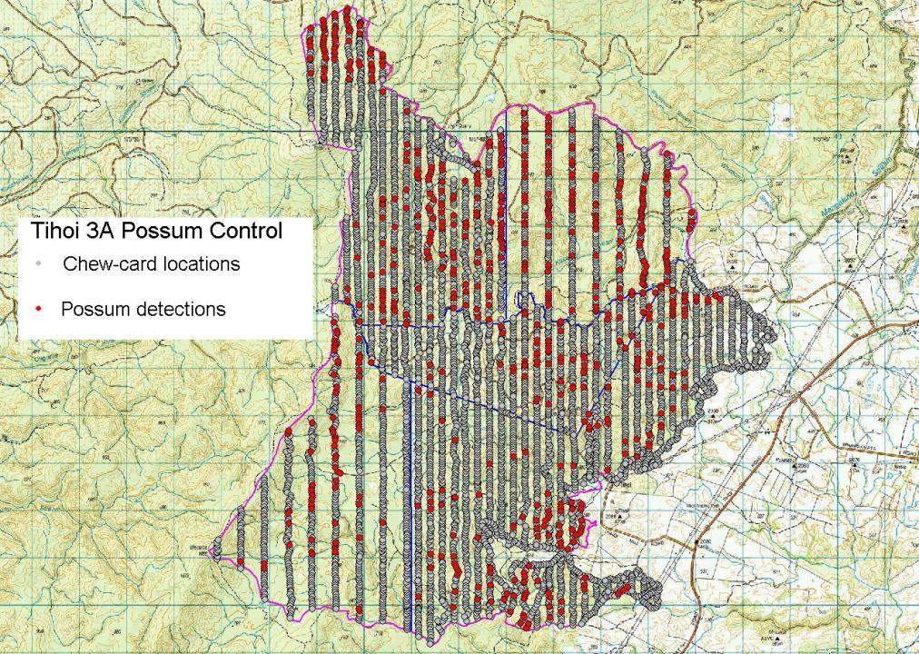
Pre-control Chew Card mapping

Slide 18
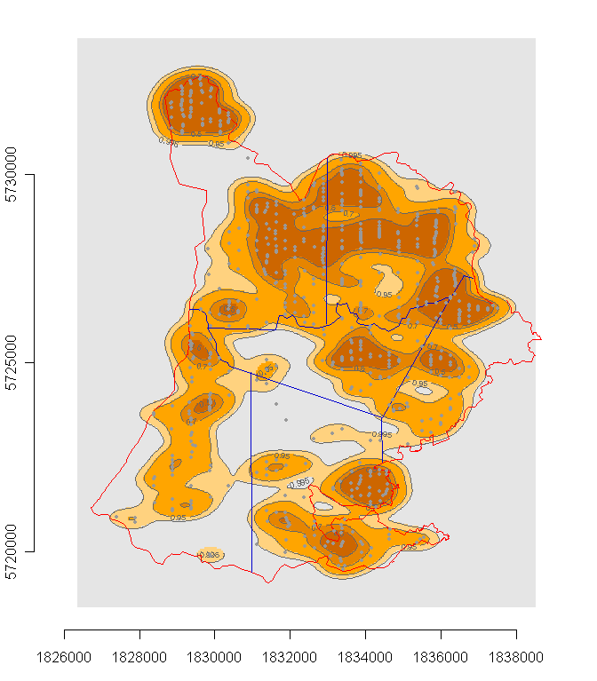
Targeting aerial cluster
CC data used to identify create ‘possum risk’ strata
Areas with few or no possums left out of aerial
Possums can be trapped and necropsied for TB

Slide 19
4. Ground-based detection & mop up
Initial knockdown by aerial (at least two aerial ops), then detection & mop up (DMU) for 5-6 years
Includes possum (as well as deer and pig) surveillance
Control efficacy low (cf aerial) but enough to prevent possum increase and further reduce TB persistence.
Lowest predicted probability of eradication
But abundant possum surveillance data (+ pig + deer) to empirically confirm TB absence.

Slide 20
Surveillance focussed options
Options 3 & 4 aim to do just enough to eradicate TB then gather evidence to show TB has gone
Potentially low cost, less aerial 1080, and faster, but surveillance largely wasted Tb still present

Slide 21
Summary
New Eradication objective is quickly driving a major change in how pests are managed for TB;
From: Putting most resources into killing possums to reduce TB
To: Putting much more effort into TB surveillance (as well) to achieve and show Tb freedom
=> Information gathering will become more important than pest control in areas close to being Tb free

