Slide 1

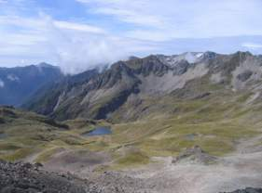
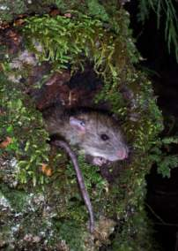
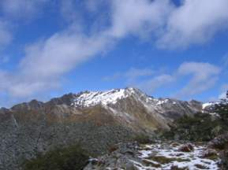
Invasive Species &
Climate Change in Alpine Ecosystems
Jenny Christie, Andrea Byrom, Warren Chinn,
Roger Pech, Mike Perry & Elaine Murphy
A joint Landcare Research & DOC Project

Slide 2
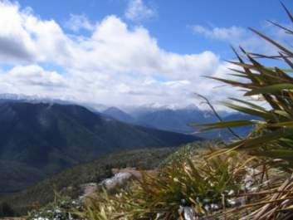
Invasive Mammals & Climate Change: Theoretical
Invasive species a major global environmental driver
CO₂ enrichment, nitrogen deposition, land use change, climate change
Can we predict the complex effects of global environmental drivers in ecosystems?
What is the effect of multiple drivers on biodiversity and ecosystems?
Notes:
If you look at the international literature, invasive species are regarded as a major global driver of environmental change. Others are …
Often however, people have investigated these effects one at a time – rarely have the effects of two or more global environmental drivers been looked at in combination. Our aim in this project is to investigate the effects of environmental change: climate change and invasive species impacts.

Slide 3
Invasive Mammals & Climate Change: Practical
DOC: practical imperative to understand rodent impacts in alpine
How often do rodent incursions occur in the alpine, i.e. how often might you need to control?
How high do rats reach in altitude? And therefore where to do control?
Understand impacts on native biota
Notes:
There is also a practical imperative to this work, and that is that from a DOC perspective we want to know three things. First, how often do rodent incursions occur in the alpine, i.e. how often should you apply control, if at all?
Second, the need to define an area of control by gaining a better understanding of how high rodents – both rats and mice – reach in altitude.
And thirdly of course and perhaps most importantly, there is a lack of information about rat or mouse impacts on native biota in alpine ecosystems in NZ, and James Reardon will go into this topic a bit more in the next talk.
(NOTE THAT IN THIS SLIDE IT’S STILL QUITE GENERAL – BOTH RATS AND MICE)

Slide 4
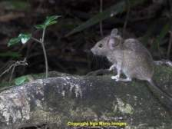
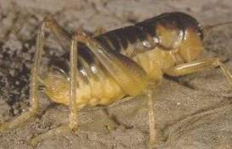
Mice and ground weta
G. Gibbs
Weta caught per 100 trap-nights
Ground weta (Hemiandrus): large flightless Orthopteran
Inverse relationship between captures of mice and weta in snap traps
Predation on weta by mice?
Mice caught per 100 trap-nights
Wilson et al 2006 DOC R&D Series, and unpubl.
Notes:
Here is just one example, which is data from Deb Wilson on the impacts of mice on weta in the Borland: when lots of mice were caught in snap traps during that study, no weta were caught. Only when mice were virtually undetectable in the system did weta get caught.
What would happen if rats were also in this system? A weta is a tasty morsel to a rat, too.

Slide 5
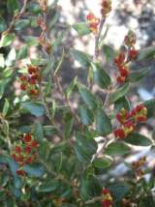
Model system: Rattus rattus in alpine ecosystems
Heavy seed years
Temperature-driven
2010
Notes:
So, the model system we’ve chosen to work on is a system where incursions of at least one of the invasive species – the ship rat – only occur periodically. I’ll come back to some empirical evidence for that in a minute, but the principle behind this is that as we all know, rodent outbreaks – both rats and mice – occur after mast years.
So as you might expect, in terms of impacts on native biota, such impacts might be most acute after mast years,
And perhaps one of the most important points we want to make is that we were looking for a model system in which the putative effects of the invasive species – both rats and mice – were periodic, in other words, where the species are not in the system all the time.

Slide 6
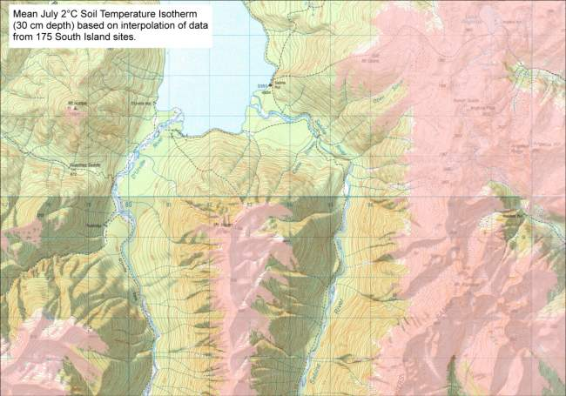

Temperature effects in alpine ecosystems ..1
Warmer temperatures
►can rats survive in alpine areas?
Notes:
So, let’s ‘unpack’ that idea of climate change effects for a minute.
There are two potential effects of temperature changes on alpine systems.
The first is a direct effect. Here is a prediction of the 2 degree isotherm of soil temperatures in July in an alpine area near St Arnaud. Under various climate change modelling scenarios, both soil and air temperatures may increase in these alpine systems. Worldwide, these kinds of biophysical effects are complex and not necessarily well understood. One thing we do know however is that ship rats cannot survive in cold areas, and the 2-degree isotherm has been postulated as a possible altitudinal limit for ship rats in NZ.

Slide 7

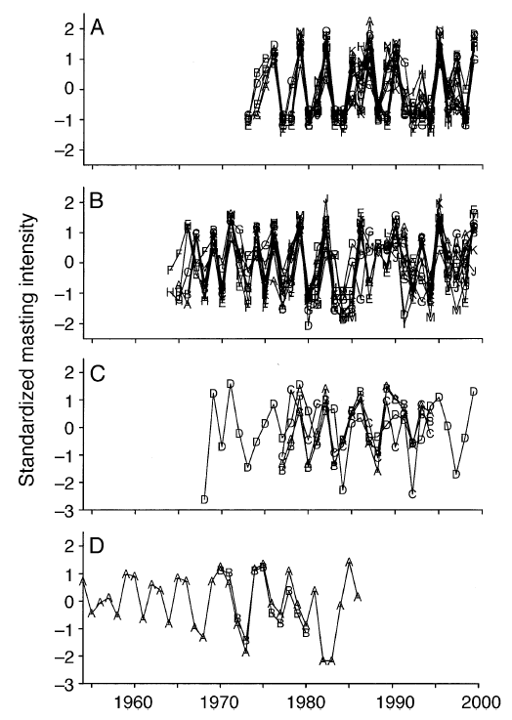
Temperature effects in alpine ecosystems ..2
Increased frequency of (temperature-driven) masting with climate change (Chionochloa and Nothofagus)
►more rat incursions into alpine?
Standardised masting intensity: Chionochloa spp. (Schauber et al 2002)
Notes:
The second effect of climate change in alpine ecosystems is indirect; as I mentioned before, we postulate that good years (i.e. mast years) enable incursions of rats from the forest into the alpine as I’ve already alluded to.
However, it does get more complicated than that, because we also have Chionochloa masts, which are sometimes in sync and sometimes out of sync with the beech.
It’s been suggested that for both Chionochloa and beech masting, the frequency of mast events may increase if temperatures increase under various climate change scenarios, since masting in beech and tussock is temperature-driven.
This could be important, because certainly forest masts, and possibly tussock masts, could result in more frequent incursions of rats into the alpine (or more frequent years with high numbers of mice).

Slide 8
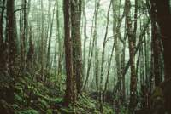
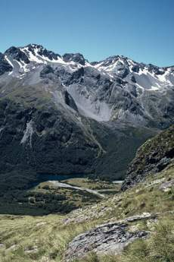
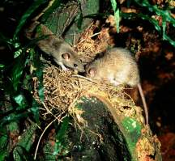
Historic data: Evidence for rat incursions into alpine zone
Mt Misery (1974 – 1993):
Ship rats only captured in pure beech stands after masting
Rats at higher altitudes in beech mast years
Temperature had no effect on capture when food plentiful
Notes:
Jenny Christie from DOC has analysed some historic data on rat incursions into the alpine zone. There were relatively few data sets available to play with, but one useful data set was from Mt Misery, for 20 years from the early 70s to the early 90s. She found some interesting things to do with rats in the alpine…

Slide 9
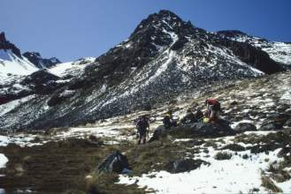
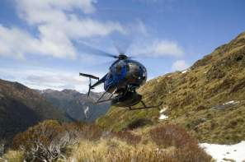
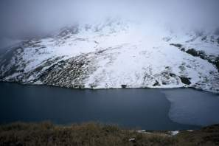
Current data: Evidence for rat incursions into alpine zone
Five DOC stoat control
operations extending into
alpine zone:
    All sites have ship rat captures in the alpine zone
    4/5 sites only detect ship rats following a beech mast
    1 site has ship rats every year, with peak after beech mast
DOC: R Curtiss
DOC: T Bliss
DOC: C Rance
Notes:
Looking at current evidence, Since 1999 / 2000 DOC has set up a large number of stoat control operations. Five of these trapping operations extend into the Alpine Zone. Ship rats are a common bycatch species. All of these sites catch ship rats in the alpine zone. 4/5 sites . . . . These sites all have red beech on the valley floor. One site has catches ship rats in the alpine zone every year, but with a peak in numbers after a beech mast. This site is different to the others in that it is silver beech with podocarp forest on the lower slopes.
Murchies
St Arnaud
Cobb
Flora
Haast

Slide 10
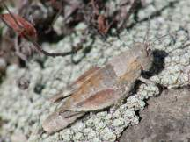

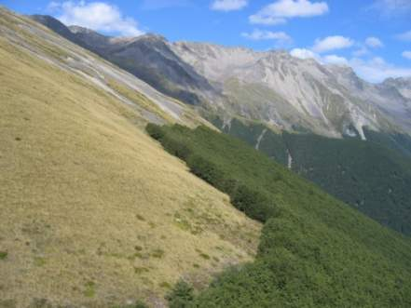
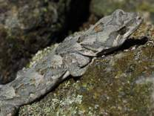
Hypothesis
The severity of long-term impacts on biodiversity increases with increased frequency of rodent outbreaks
Notes:
Our hypothesis was…
… essentially, for the purposes of our study, this equates to an increased frequency of incursions above the bushline.
With climate and masting as the mechanisms driving this hypothesis

Slide 11
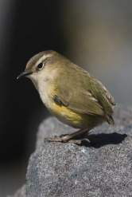
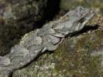

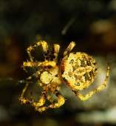
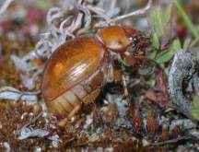
Predictions
J Reardon
5 categories of invertebrates:
Bystanders (non-responders)
Refugees (recolonisers)
Compensators
Diminishers
Beneficiaries
Notes:
Roger mentioned earlier this morning, some work that he and Clare Veltman have been doing, thinking about how you might categorise functional groups of native biota in terms of their vulnerability to invasive mammals. We’ve used all these categories do develop some predictions for how we think native invertebrates might respond in mast years when rats invade alpine areas.
They could be…
Note that to date, our focus has been on invertebrates. We might build in other groups of native biota, such as birds and lizards, later – and James and his crew are already thinking along those lines as you’ll see in a minute.

Slide 12
500 m
High alpine
(x1)
i
i
Above treeline
(x1)
i
i
Below treeline
(x2)
i
i
Key:
Line
Tracking tunnels, 10/line
Fruit counts; quadrats along transect
Seedfall traps, 3/line
Litter sampling, 3/line
Invert pitfalls, 1 lot of 5 spaced at 1-m intervals, x 3/line
Tussock tillers; count on transect
i
iButtons; 1 pair on stake at each station; 1 at ground level and one at 1.0m; 2 stakes/line
Notes:
In a nutshell this is our experimental design….
Each of these is a replicate, and so far we’ve got two groups of two reps…

Slide 13
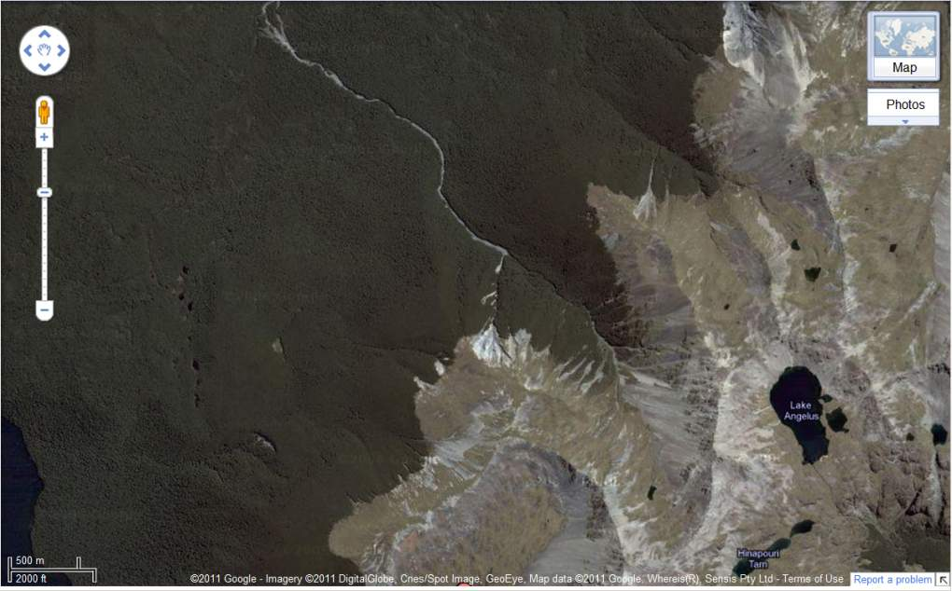
Mt Cedric: Non-Treatment
Notes:
One, which we’ve called the non-treatment site, is situated at Mt Cedric between Lakes Rotoiti and Rotoroa in Nelson Lakes NP.

Slide 14
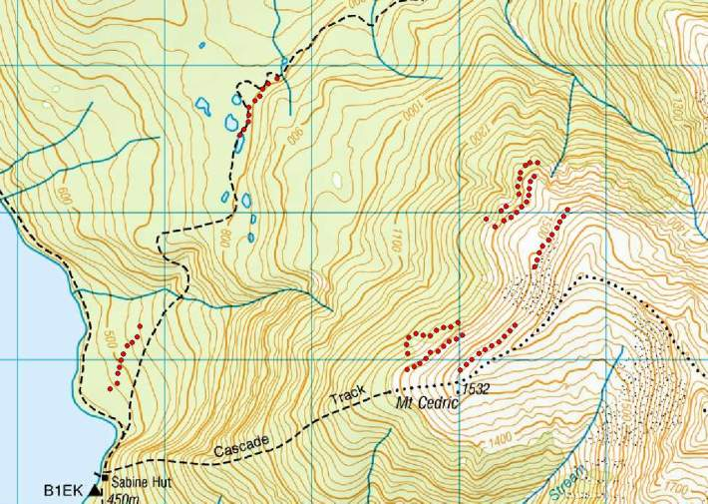

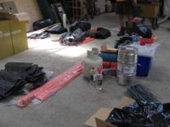
Mt Cedric: Non-Treatment
Established February 2011
Notes:
This is the location of our lines at Mt Cedric. I should mention at this point that Mike Perry, Dean Clarke and some contractors have done the hard yakka in the field to set this all up for us, but Andrea and I do actually plan to be ‘on the ground’ in May on the next trip!

Slide 15
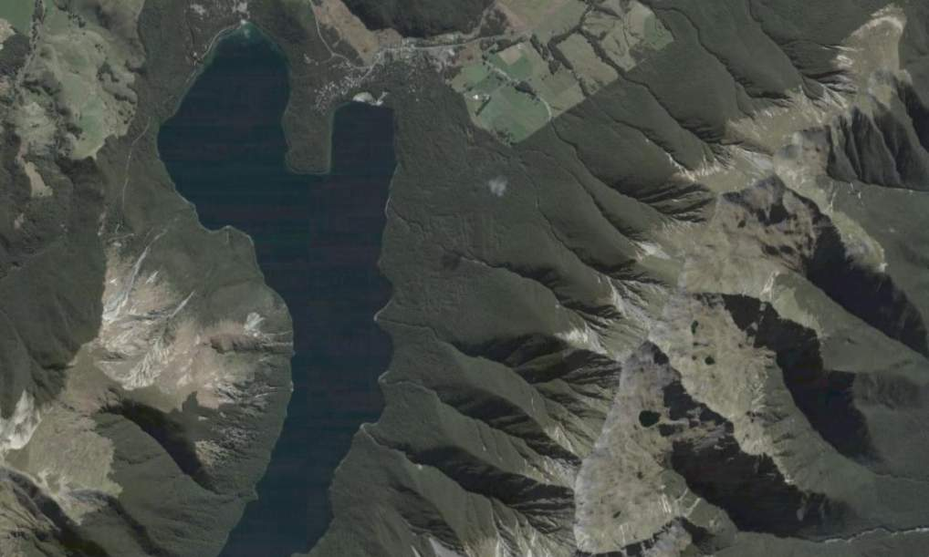
St Arnaud: Pest Removal
Notes:
The ‘treatment’ site is situated within the St Arnaud Mainland Island, and we chose this site because were interested in whether our species of interest may already have responded, in a site that’s undergone long-term pest control.
Treatment site, pest removal, stoat trappping and rodent control using bait stations and toxins

Slide 16
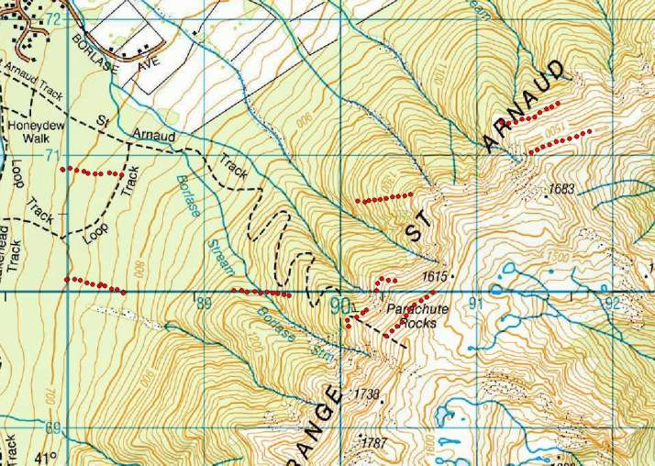
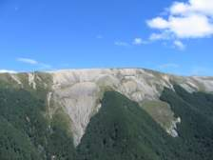
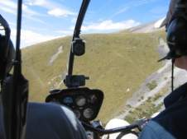
St Arnaud: Pest Removal
Established February 2011
Notes:
We’ve also made use of existing tracing tunnel lines at St Arnaud, so we can get a head start on some prior data, hence the different orientation of these lower bush lines.
And this slide reminds me to that the DOC staff at St Arnaud, who have been extremely accommodating, both of our wacky ideas and of our physical presence.
All of this was established in February, so it’s quite new, and we haven’t worked our way through the preliminary results yet.

Slide 17
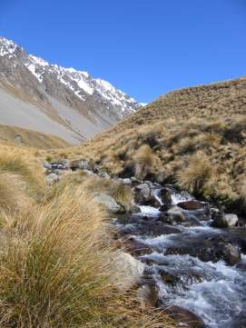
Beyond Nelson Lakes
Extensive monitoring at DOC operational sites
Allows results to be generalised across a range of latitudes
Notes:
So that wraps up what we’re beginning to call the ‘intensive’ part of this project. However, there is also another dimension to this which I’ve been working on over the last few months. There is a lot of interest and concern in DOC about alpine areas, and our relative lack of knowledge about how to manage threats and conserve native biota in these ecosystems.
So we’re also beginning to establish what we’re calling the ‘extensive’ part of this project, which goes well beyond Nelson Lakes. This will allow results to be . . .
Also involved in this part of the project are Josh Kemp and Graeme Elliot

Slide 18
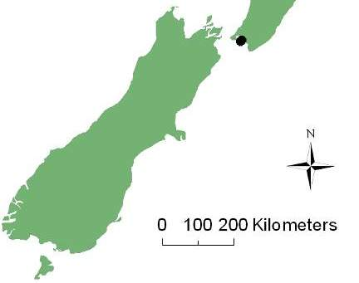
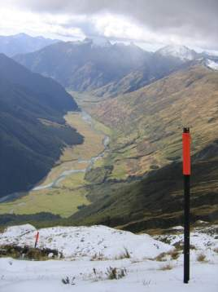
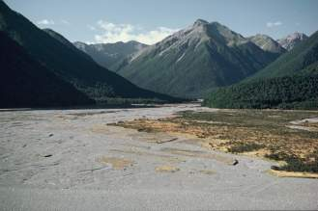
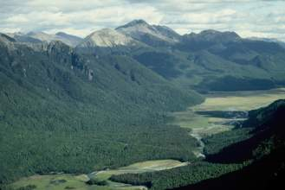
Three sites proposed
Hawdon
Eglinton
Dart
DOC: B Smith
DOC: B Rance
DOC: T Ensom
Notes:
These sites are all DOC operational sites
So they already have monitoring occurring
They have ongoing stoat control using trapping
They have periodic rat control using aerial 1080
Associated with these sites are non-treatment areas
The other thing these sites all have in common is that they all have red beech present on the lower hill slopes and valley floors

Slide 19
Lower intensity monitoring
Rat tracking
Beech seedfall
Temperature
DOC: B Smith
DOC: B Rance
DOC: T Ensom
Notes:
In keeping with the extensive monitoring, the monitoring at these sites is much lower intensity. In that rat tracking, beech seedfall and temperature will be monitored but not invert or fruiting and tussock seeding at this early stage.
These sites already have rodent monitoring, using tracking tunnels, on the lower hill slopes. We will add more tracking tunnels, up as far as the bush line, but not into the alpine zone at this stage.

Slide 20



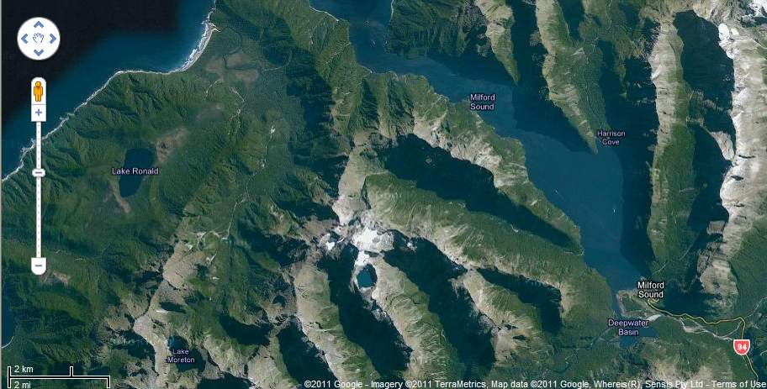
Sinbad Gully
Fiordland endemics and alpine ecosystem

Slide 21
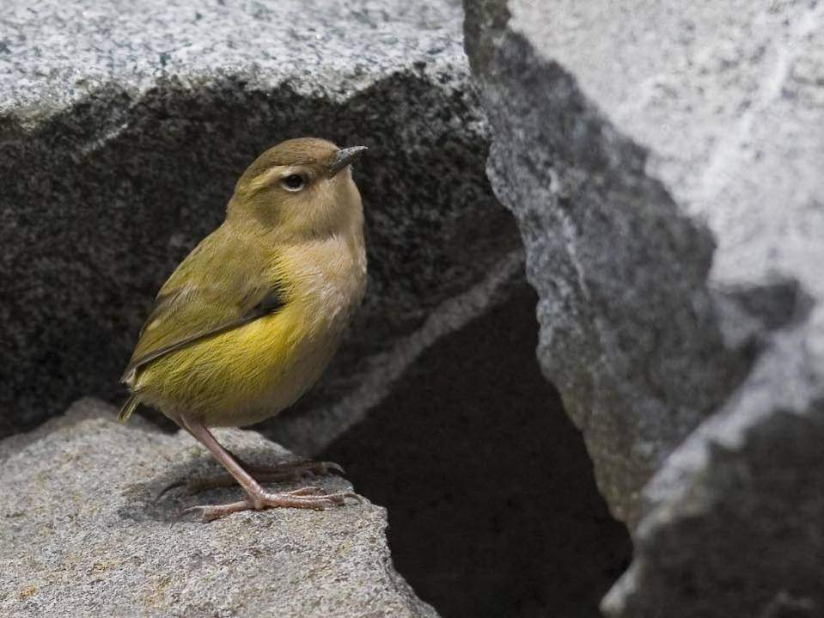
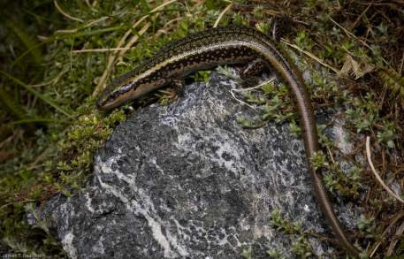

Slide 22
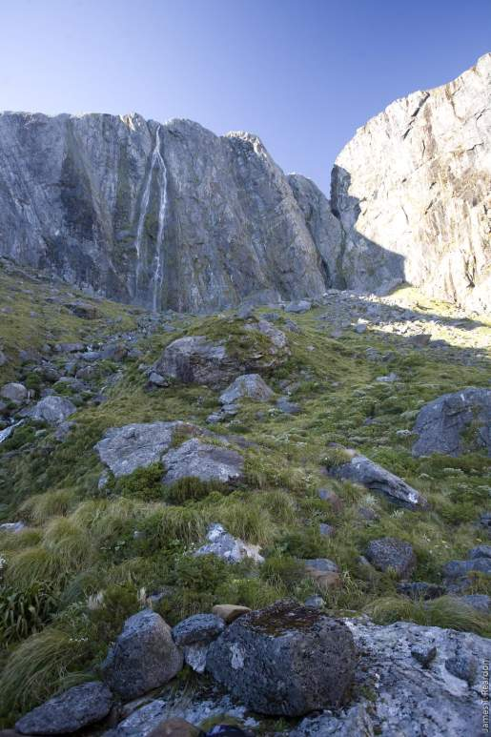
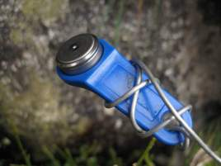
Climate and rodents
Four ink-tunnel lines (10 tunnels 15m spacing).
Four groups of temp/RH data-loggers

Slide 23
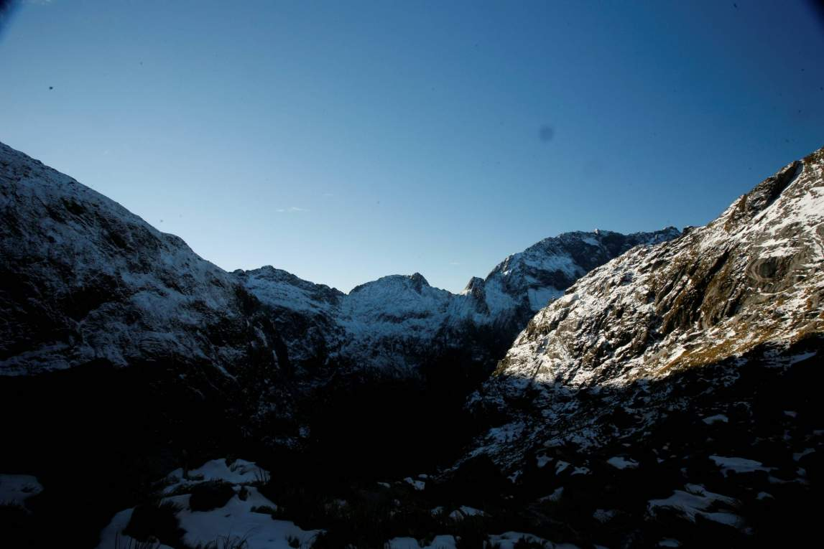
Notes:
Run through winter

Slide 24
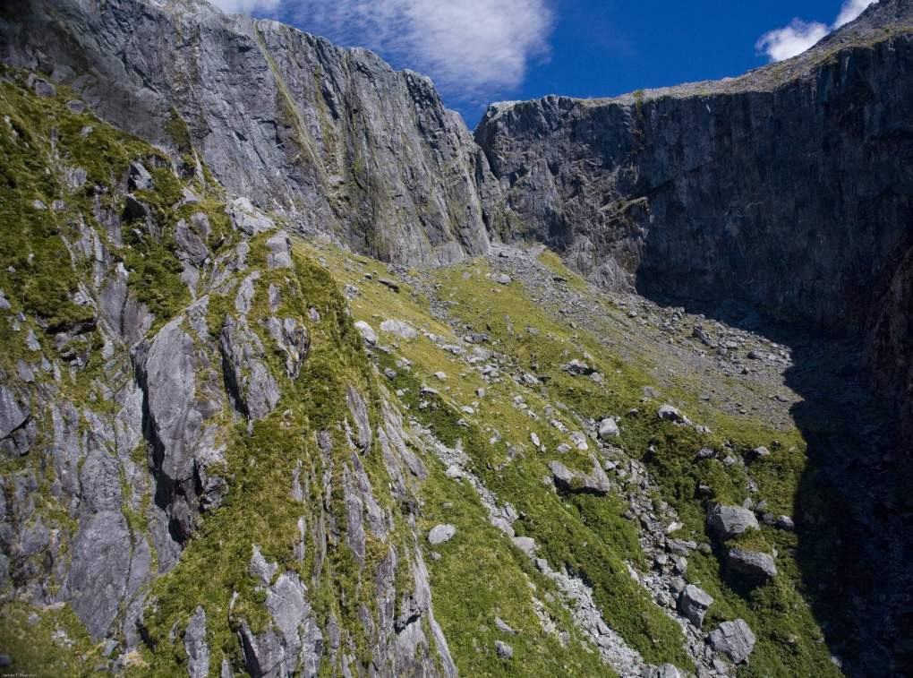
C
B
A
D

Slide 25

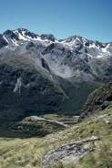
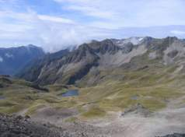
The Future
Intensive:
More replicates at each site
Use of exclosures – rodent removal in mast years
Extensive:
Increase number of sites
Other:
Presentation at ICCB 2011 conference
‘Alpine’ symposium EcolSoc 2012
Modelling of species interactions
Re-do Mt Misery trapline?
Integrate with DOC Fiordland

