Slide 1
160 Gloucester Street
48Hr Design Challenge
CREATIVE CHRISTCHURCH FUTURES
Colin Meurk, Roger Buck, Ian Lynn, Will Allen, Anna Stevenson, Josh Thompson, Adrian Viegas
(hosted by Landcare Research – Manaaki Whenua)

Slide 2
Key Aspects/Principles of the Project
Set within Social, Cultural, Ecological, Transport & Economic Context
… across Site, Street, Inner City & Wider City scales
Connectivity to adjacent Streetscapes, Architecture, wider inner City Design, Activity Hubs, Green Infrastructure & Maori History
Sustainable, Sensitive & Relevant to Economic/Authentic Tourism & Youth, Aged and Multi-Cultural needs
Vision for High Performance Building in a very limited site
Continuing the Latin/Romanesque theme of New Regent Street
An element of a Reborn, Exciting, Safe, Historically Inclusive & Legible City

Slide 3
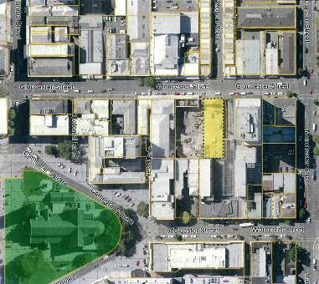
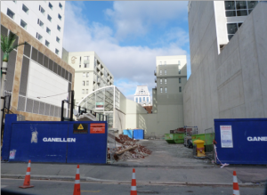
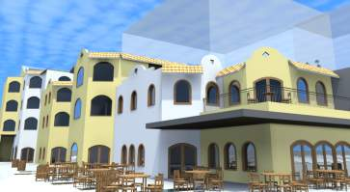
The Site
160 Gloucester Street
Before
After

Slide 4
Key Features of Building
CONTINUES ROMANESQUE THEME of NEW REGENT STREET HERITAGE PRECINCT
Environmentally sensitive - e.g. power / thermal
Low energy losses - e.g. insulation
Predominantly natural ventilation
Green roofs & walls
Enhances use of adjoining open spaces
Engineered timber structure (LVL - Expan system)
Future proofing

Slide 5
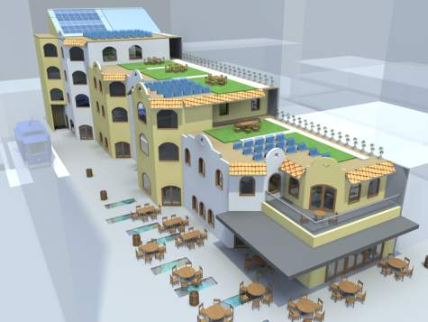
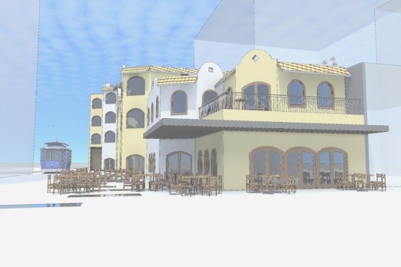
3D - Perspective
External render of shop fronts to Gloucester St
windows insulated against adjacent tram noise
Aerial view of green roof, solar panels, common roof garden spaces for tenants, stormwater collection chanelling to rain garden on street

Slide 6
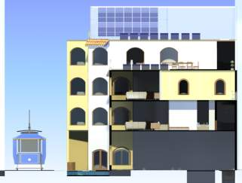
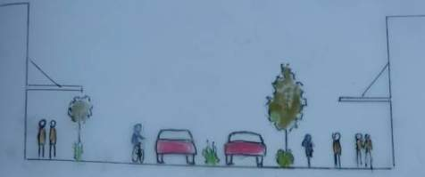
Cross Section
East Section
Street Section (30kmph)
North Section

Slide 7
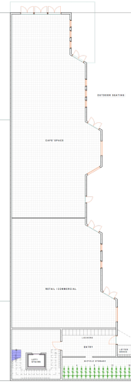
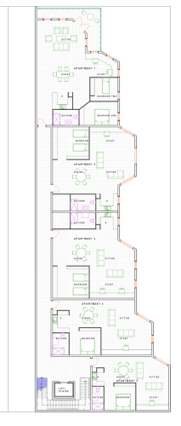
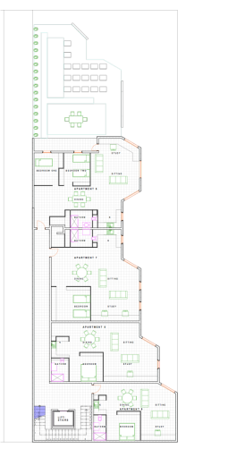
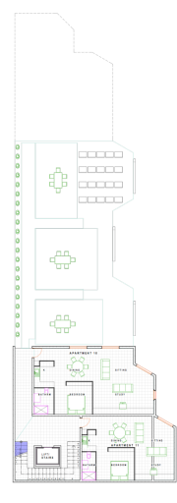
Spatial Plan
Ground Floor
First Floor
Second Floor
Third Floor

Slide 8
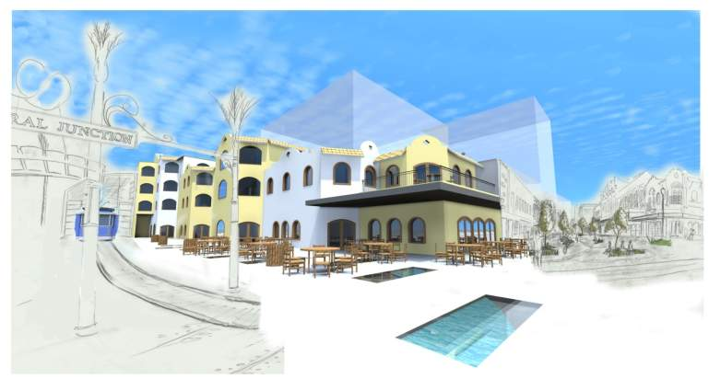
StreetScape Perspective
Integration with New Regent St (Romanesque) - Retail, walking, cycling, tram & service vehicles
Provides for limited green space use of rare indigenous spp / taonga of the dry plains, dunes & riverbeds in roof, walls & pavement cracks
Springs running through river stone paving in braided pattern - revealed through hard ground surface glass – filtering through rain gardens before picking up ancient tributaries of Avon/Otakaro – ultimately issuing to wide green riparian corridor to sea

Slide 9
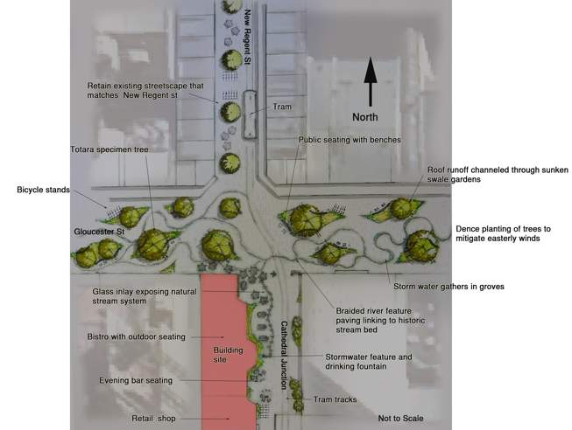
StreetScape Plan

Slide 10
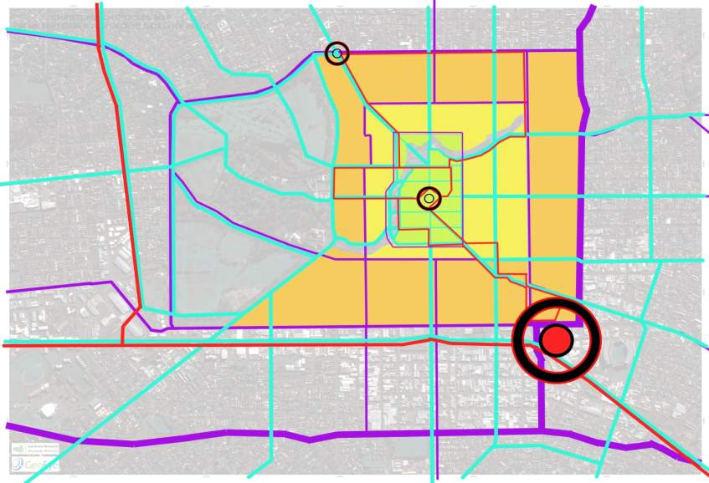
An Inner People-Friendly, Vibrant City
Activity & Traffic Plan
Car-free centre (green), street calming (yellow), residual traffic (orange), cycle-ways (blue)
Extended tram system to new Hub in SE quadrant (Based around CPIT, AMI stadium , QEII, Conference Centre, etc.) – AND to University/Riccarton Hub in NW quadrant
Re-connect light rail commuting from Rangiora/Kaiapoi, Lyttelton/Ferrymead, & Rolleston to SE Hub
Enticing people to city centre through sports, events, entertainment – SE Hub

Slide 11
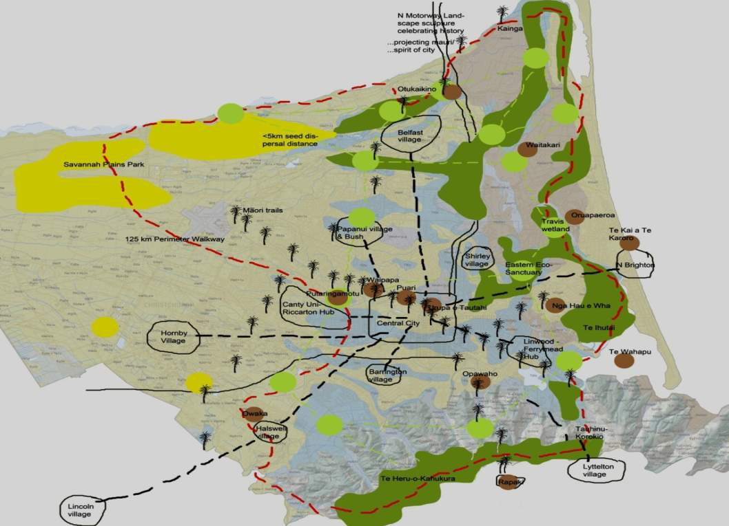
Wider City Context/Key Features enlarged map over page
Structure & ideal strong links of suburban Villages & Hubs to Central City (black circles)
A much stronger/faster connection between Canterbury University/Riccarton education/commercial/service/food /entertainment Hub to Central City via tramway
Optimum configuration of habitat patches & linkages that feed wildlife thru urban forest (pale green nodes), an Eco-Sanctuary in red zone E of ‘Palms’, & Plains Savannah Park in NW (yellow)
Highlights traditional Maori sites of significance – kainga, pa, mahinga kai, urupa (brown nodes), & key trails/routes from Te Waihora to Kaiapoi, to Rapaki & across plains to West Coast (Ti Kouka symbol centred on Burnside HS & with companion noble podocarps, kowhai & kanuka according to soil/drainage conditions)
Motorways to be transport sculptures weaving into the city – projecting its multi-dimensional history with reference to Maori places, natural habitats, colonial farming & forestry
Perimeter walkway (red dashes) encapsulating natural & cultural history & a revitalised eco/recreation tourism business – a place to be (not a place to pass through)!
Planned retreat from the coast in response to sea level rise

Slide 12
Wider City Context
S Motorway

Slide 13
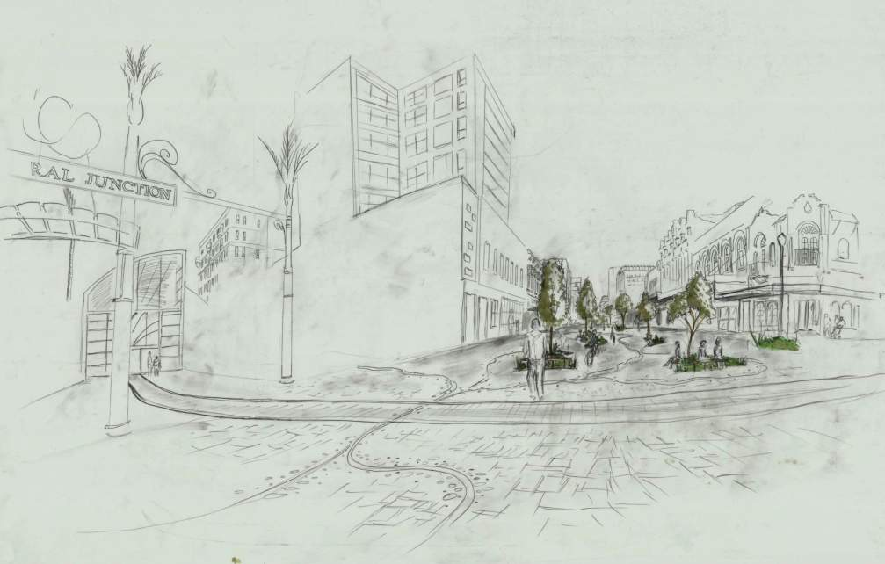
Conclusions
An Eco-Recreation City – alive, safe, nurturing diversity, learning, health, exercise & business
“Green” hi-tech wooden structured building with native planted green roof
Insulates & attenuates storm water - trained & visible thru site, reflecting older waterways & symbolizing Maori traditional connection with water
Storage for bicycles;
Offices/flats with common services
roof top gardens, showers for cycle commuters, washing
Linked to:
Colonial Heritage Precinct theme
Maori taonga & cosmos
Integrated transport/communication links
Villages & Hubs
Entertainment, Activity & Sports centres
Trees:
Totara
Kowhai
Manatu
Ti Kouka
Houhere
Kanuka
Rain Garden: oioi, purei, panakenake, umbrella sedge
Traffic Islands: mikimiki, knobby clubrush, pohuehue, korokio, niniao, NZ broom (for insects & lizards)
Paths & Roofs: cotula, puha, gossamer grasses, geranium, creeping pohuehue

Slide 14
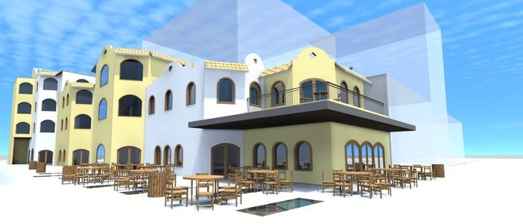
Conclusions (continued)
Blank walls of adjacent buildings decorated with living wall attachments & art works – an aerial rendering of Port Hills profile to south suspended between buildings & featuring Te Heru-o-Kahukura & Tauhinu Korokio & sculpting onto BNZ building up N view shaft thru New Regent St a profile of Maunga Tere
By implementing developments similar to this design the city will regain a sense of life, excitement & sustainability.
Key components will be to provide safe venues for entertainment for young people - designed and policed by a youth council; respect & integration of elders into life of city; zero tolerance of anti-social activity; & life affirmation

