Slide 1
Wildlife TB in the North Canterbury High Country-
A Research Update.
Ivor Yockney, Graham Nugent and Jackie Whitford
Landcare Research, P.O. Box 40, Lincoln 8142

Slide 2
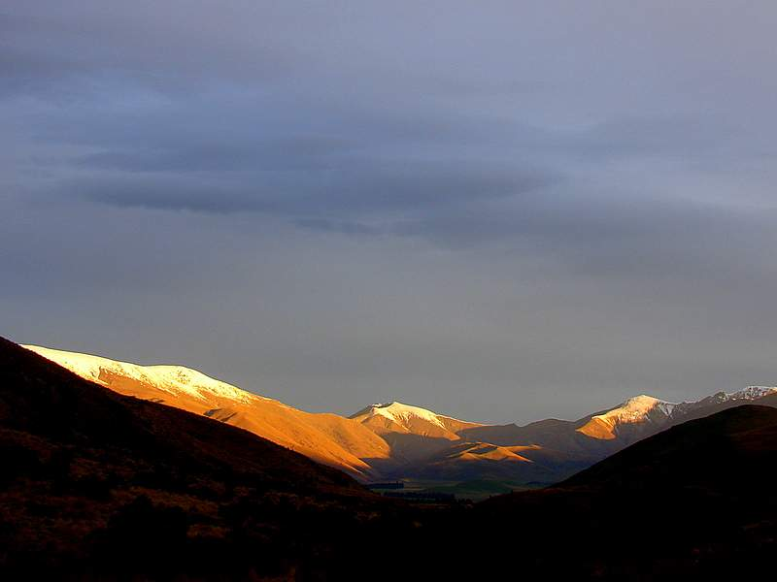
Background
Much of South Island high country not included in current NPMS
  Few herds but vast size made it too expensive [on a cost/herd basis] to attempt to reduce TB in livestock.
  But some control and research initiated in partnership with AHB/MSI
  Studies summarised:
  Reduced coverage/ sowing rates for aerial control
  Effect of control on TB levels
  Home ranges of TB sentinels and wildlife
  Ultra low aerial 1080
Notes:
This talk is basically a background to ongoing work based on Molesworth Stationa nd the Clarence Reserve, some of it nearly complete while other parts are just beginning.

Slide 3
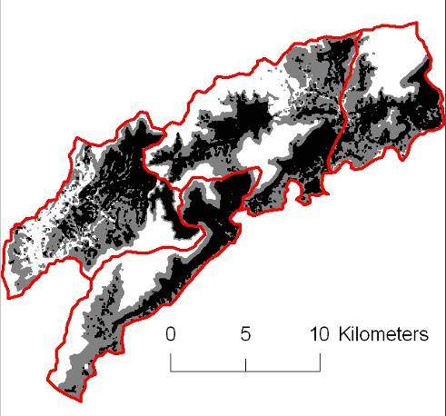
1. Reduced coverage and sowing rates
for aerial possum control
In 2008, 28,500 ha aerially poisoned to test cluster sowing and reduced coverage as ways of reducing control costs
- 4 treatments applied
3
4
2
1
Black areas > 10% predicted TCI
Grey areas > 5% predicted TCI
Notes:
Started in 2004 Parts of the high country hold too few possums for TB to persist
Question: Can these be reliably identified and left out?
Research initiated to identify if costs could be reduced by reducing coverage and sowing rate ground and sattelite data to predict habitats.
Obviously next way to lead on from that study was to test it with an operational job which was completed in October 2008 using both limited covergae (i.e only controlling risky habitat) and reduced sowing rates by using the cluster technique.
Coverage = % of area of block

Slide 4
Immediate reduction in possum activity
Overall Chew Card Index decline of 91%
Highest kills in low density blocks (= high coverage)
Notes:
These blocks were monitored using chewcards and also monitored with 103 RTC lines and showed that same pattern, with no difference between broadcast and cluster sowing

Slide 5
Subsequent recovery
Chew cards and wax tags used to estimate possum abundance 1 & 2 years post control
Cluster sown
Broadcast
Notes:
Looking at Wax Tag index as a % of pre control index we have a steady increase in possum index through 2009 and 2010. Overall possum index is 39% of pre control levels which is higher than biologically possible – therefore shows an immediate post control index bias. Blue lines are low coverage, black lines are high coverage.

Slide 6
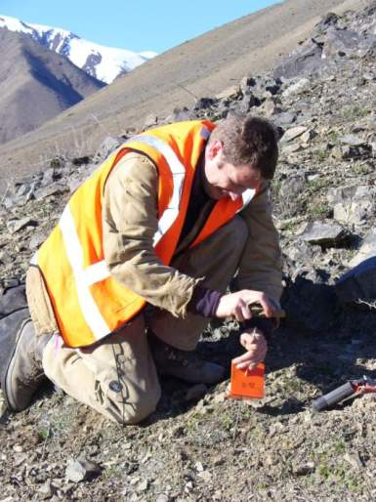
Rapid increase in apparent possum abundance
Overall nearly a six-fold increase in CCI from 8.3% (2008) to 49% (2010)
This increase is well in excess of reproductive capabilities of possums so therefore a biased-low post-control CCI
=> the kills were not as good as we thought they were?
  First time this has been found in unforested habitats
Notes:
Low bias CCI is similar to what is now recognised as biased low RTCI post control – unforested areas (2D habitat) first time reasons around this.
The question is : was control effective enough to eliminate TB in possums?

Slide 7
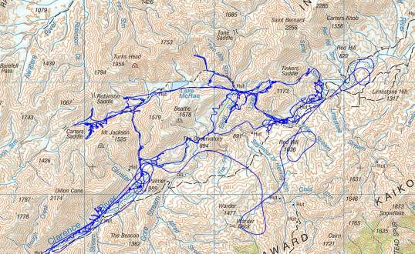
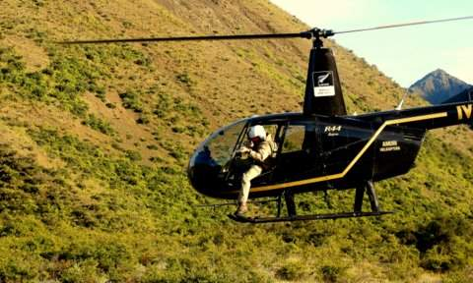
2. Effect of control on TB levels
Pre-poison TB prevalence in resident pigs
Molesworth poison area:
2004 (n = 18) 94% prevalence
2005 (n = 37) 95% prevalence
2006 (n = 25) 76% prevalence
Notes:
You could generalise and say that Molesworth had a TB problem, high TB prevalence in these areas prior to control

Slide 8
Post-poison TB levels in released sentinel releases
Site | N sentinels recovered/ released | Exposure Time (years) | TB (gross diagnosis)
Molesworth (poisoned) | 42/64 | 29.2 | 3 (7%)
Clarence Reserve (unpoisoned) | 12/18 | 5.7 | 5(42%)
=> Far lower force of infection in 1080 poisoned areas despite the moderate kills and quick recovery of possums`
Notes:
Tb animals from Molesworth: All from the first release of animals soon after the poison operation. Average 65% recovery rate due natural mortality and hunting pressure.
82 pigs released total – 54 recovered for necropsy and exposure time shown in years.
Molesworth exposure time nearly 29 years.
Clarence only 1/5th the exposure time and 42% prevalence so showing a clear difference in possum controlled areas

Slide 9
Post-poison TB levels in resident pigs
Year | Molesworth %TB (n ) (Poisoned) | Clarence %TB (n ) (Unpoisoned)
2008 | 80% (21) | 75% (4)
2009 | 81% (16) | 64% (28)
2010 | 26% (38) | 58% (65)
2011 | 39% (136) | 61% (64)
=> Major decline in TB after poisoning but still high and no longer decline
=> TB still in possums?
Notes:
However when you look at resident pigs (2008 and 2009 had a large sample born before possum control), then there is a large decline in TB levels followed by an increase in 2011. Sentinels were also brought in in 2011 with no TB

Slide 10
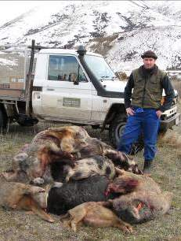
2. Impact of control on
TB prevalence
Even moderate possum control has had a major effect on reducing possum-cattle TB transmission
To measure the true success of the operation (in terms of reducing/eliminating TB) monitpring of cattle TB and conducted a program of ongoing surveillance through the use of released sentinel pigs.
Combining the use of sentinel
pigs as Judas animals for finding resident to
increase efficiencies of TB
surveys
Notes:
Obviously the outcomes of TB control on cattle is the Holy Grail and this chart shows the general tracking of the Molesoworth herd since control began on the early 2000’s. Now very few (if any) lesioned reactors found at slaughter

Slide 11
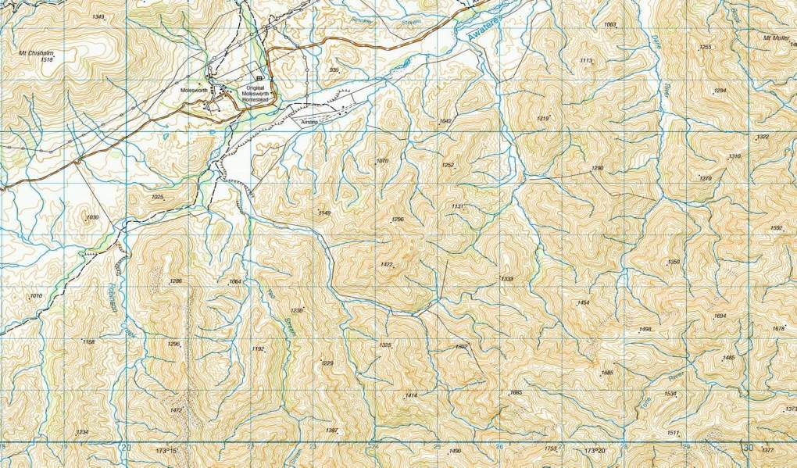
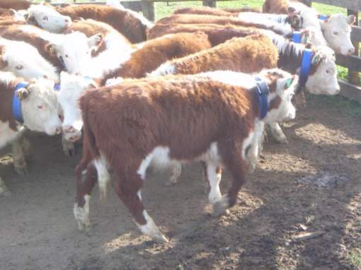
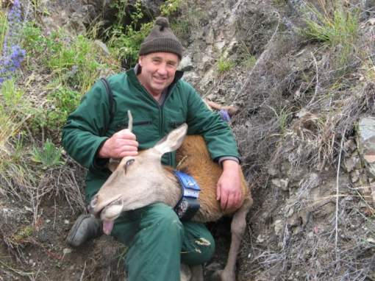
3. GPS tracking of cattle, deer, pigs and possums
Notes:
Part of the “Sustaining TB freedom” program looking at kernel estimates of home ranges of the main TB reservoir/sentinel species. Important to know that if TB is found what kind of area are we looing at depending on species

Slide 12
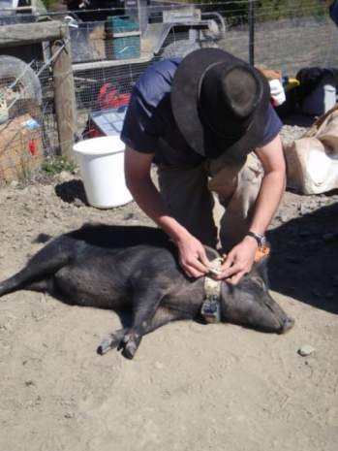
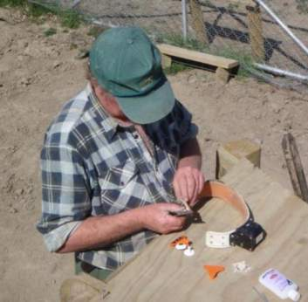
GPS animal tracking
Better understanding of home range and utilisation, and their relative utility as TB sentinels
Most robust home range data set yet covering four major TB hosts in a single place (habitat)
Largely unanalysed at present so presenting preliminary results
Notes:
This conducted at the same time as the Molesworth study
Even with high attrition of collars and malfunction the data provided is well in excess of anything collected off pigs to date.

Slide 13
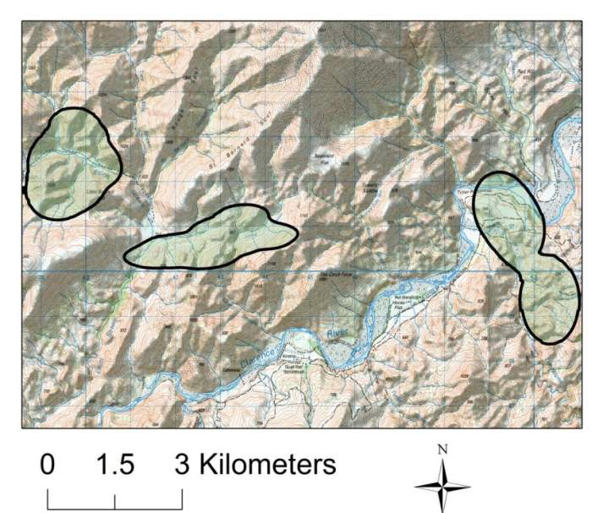
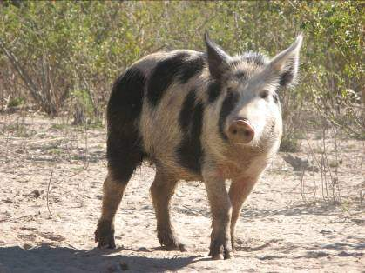
Pig home ranges
Mean = 4.2 km²
Max = 10 km²
Min = 1 km²
N=9
Notes:
Stats is only on 9 animals so far, 3 of which are shown here.

Slide 14
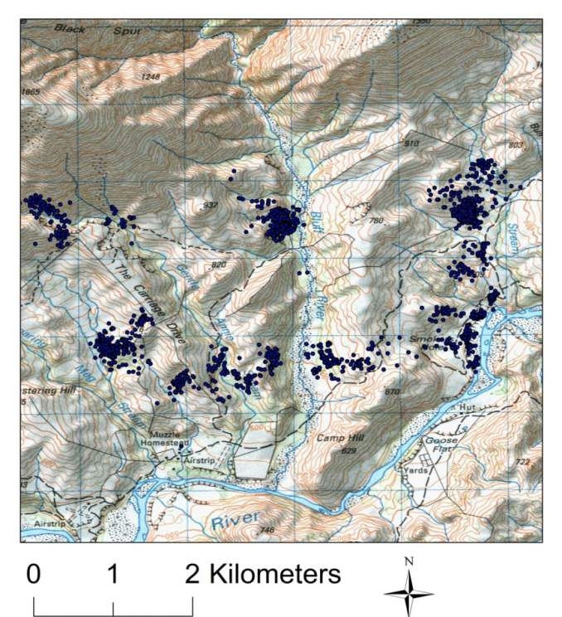
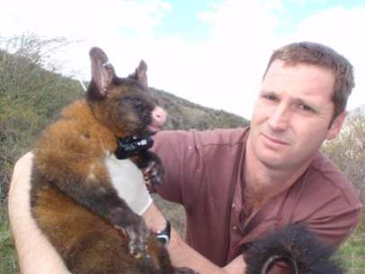
Possum home ranges
Mean = 18.6 ha
Max = 40.0 ha
Min = 0.7 ha
N= 26
Notes:
Useful data from 26 collars, shown here.

Slide 15
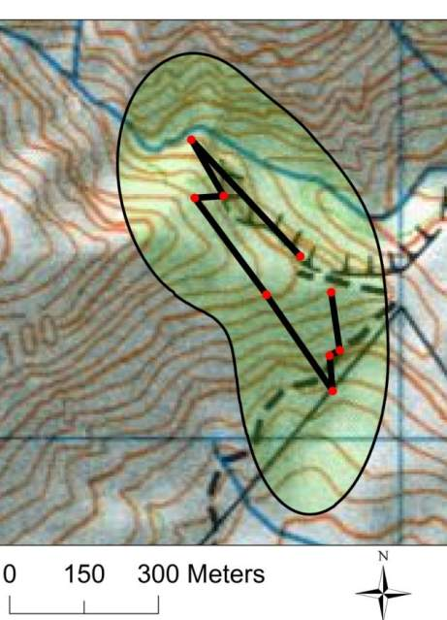
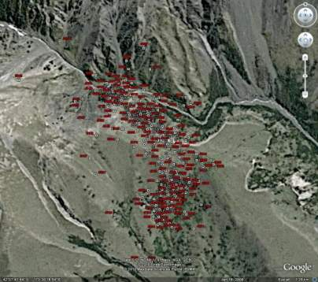
Short-term range use
adult male possum used most of its large home range within a 7-day period
=> more frequent interactions with devices - overestimates density?
Notes:
Shows the same possums over 7 nights as opposed to 4 months, covers much of his home range, this may result in more frequent interactions with devices even with fewer possums in this habitat – perhaps we overestimated possum density due to these large home ranges? Other management implications include the spacing of poison/flight lines – we have recently used reduced sowing rates and spacing out to 500m with good effect in this habitat.

Slide 16
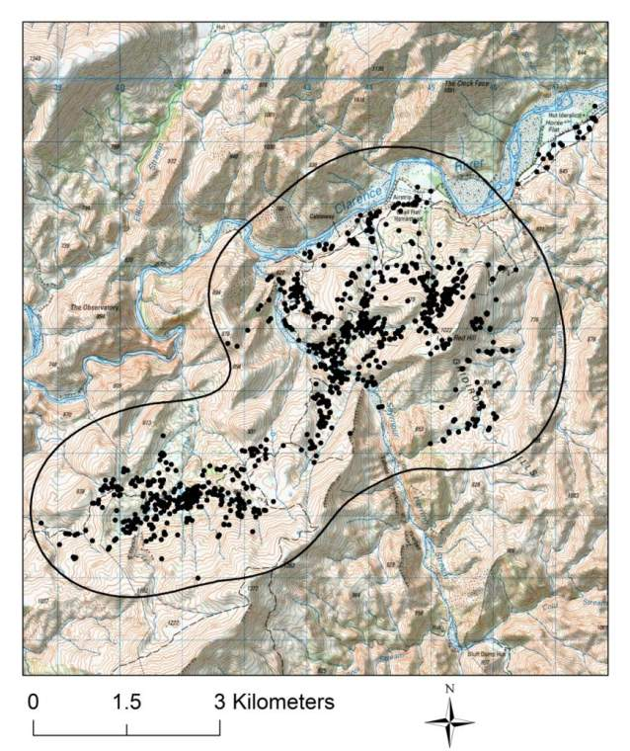
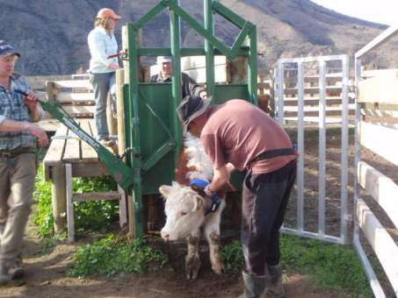
Cattle home ranges
Mean = 38 km²
Max = 112 km²
Min = 15 km²
N= 20
Notes:
People ask why put collars on cattle –surely you know what paddock you left them in??
For previous Molesworth study we had to resort to U.S data for cattle home ranges as a best guess (200 ha?), now we have a much better idea of the amount of landscape they cover.
A single example of a hereford steer over 114 days is shown.

Slide 17
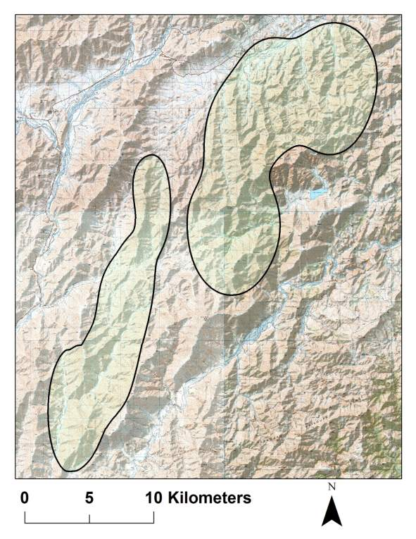
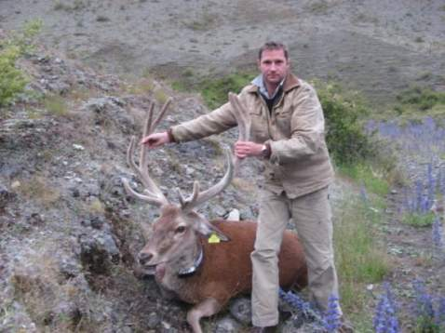
Deer home ranges
Mean = 76 km²
Max = 173 km²
Min = 22 km²
N = 13
Male
Female
Notes:
15 deer collared, combination of stags and hinds, 14 recovered – data is for 13 at present

Slide 18
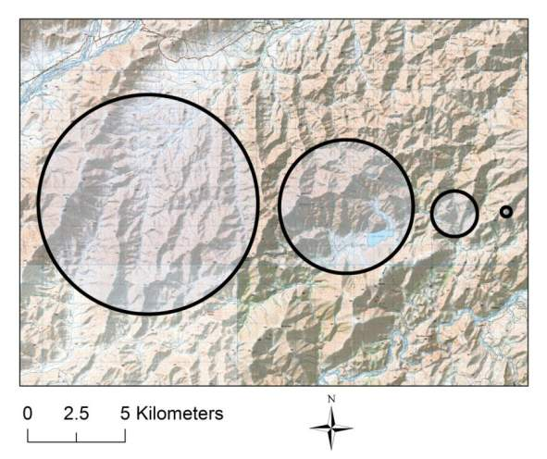
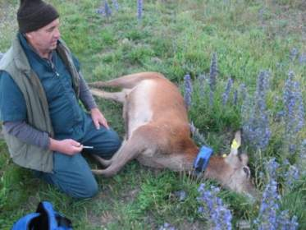
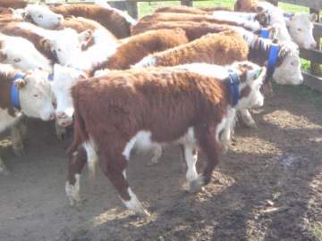
Notes:
Just to broadly depict the order of magnitude in home range sizes between the 4 species. If you were to find Tb in any of these species this is the kind of detection area you would likely be looking. Remembering the deer is only 1 animal at present so may exceed normal home range.

Slide 19
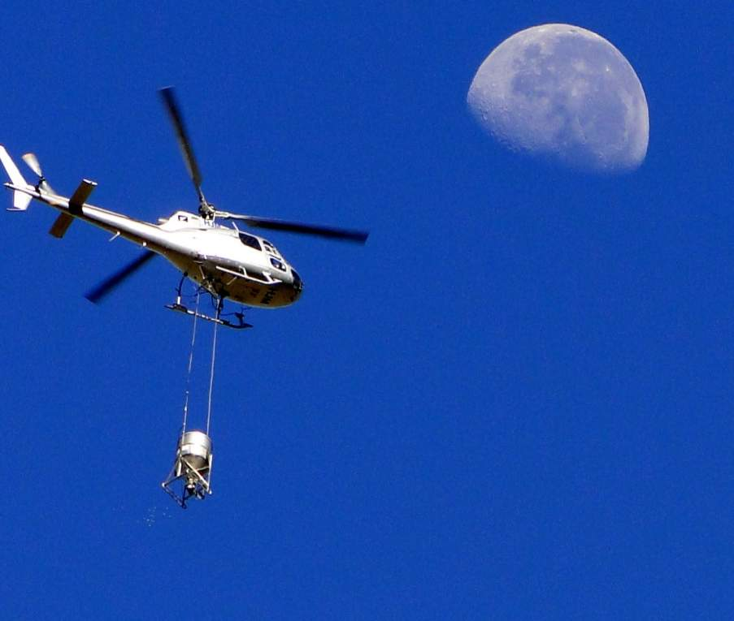
4. Ultra-low aerial
As part of large scale test of a possum vaccine four 1000-ha areas aerial poisoned to produce a high kill (2 areas) or moderate kills (2 areas)
Cluster sowing operation, Feb 2011.
Notes:
WE only wanted moderate kills in order to use an aerially delivered vaccine to the survivors.

Slide 20
Ultra-low aerial results
High knockdown aim:
  100m FPS, 500g/ha prefeed
  300g/ha toxic
17/18 (94%) radio collared possums killed
Moderate knockdown aim:
  500m FPS, no prefeed,
  60g/ha toxic,
25/33 (76%) possums killed
Notes:
Even with the high knockdown – only 1/10th of the toxin as per a normal operation was used
Moderate knockdown at 500m spacing's shows what can be achieved at very low cost in these habitats – again 500m spacings probably worked due to possum movements in this habitat.

Slide 21
Management Implications
Rapid recovery after cluster and reduced coverage poisoning
  First evidence of post control possum detection bias in unforested areas
Despite only moderate control on Molesworth, cattle and sentinel pig data suggests a major impact on TB levels
Home range data suggest much wider ranging movements than first thought – implications for possum detection and control
With prefeeding, very little 1080 needed in this low-possum density area
Notes:
Whether or not it’s a true rapid recovery?
Reduced costs could lead to either faster and/or cheaper TB eradication in the high country.

Slide 22
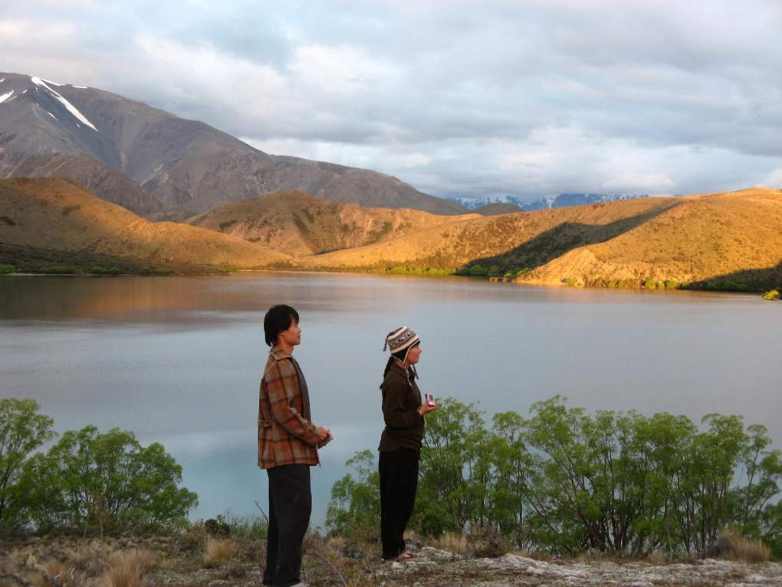
Acknowledgements
Animal Health Board, FRST/MSI and Landcorp Farming for operational and research funding, Jim Ward (Molesworth Station), Colin and Tina Nimmo and staff (Muzzle Station), Amuri Helicopters.

