Slide 1
Community participation and vertebrate pest control
Alison Greenaway and Bruce Warburton
Landcare Research

Slide 2
MSI Strategic Technologies for MSPC Programme Objectives
Obj 1: Reducing the costs of aerial and ground- based control
Obj 2: Reducing the adverse impacts of aerial and ground-based control (welfare, residues, non-targets)
Obj 3: Reducing community opposition to pest programmes (increasing community participation in pest programmes)

Slide 3
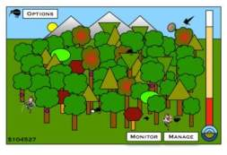
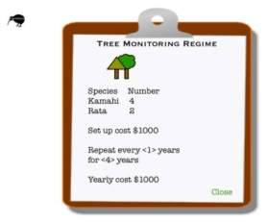
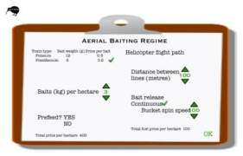
Objective 3 Community participation in pest programmes improved
Key Questions:
Can the mismatch between public concerns and current scientific consensus over methods used for possum control be effectively addressed through improved community dialogue? (Alison Greenaway, Bob Frame, Helen Fitt, Bruce Warburton, Phil Cowan),
Can ecological games (model visualisation) provide an effective medium for informing community participants of the economic and ecological consequences of their choices? (Pen Holland)
Partners & collaborators
Clare Veltman, Harry Broad, Michelle Crowell (DOC)
John Deal, Nick Hancox (AHB)

Slide 4
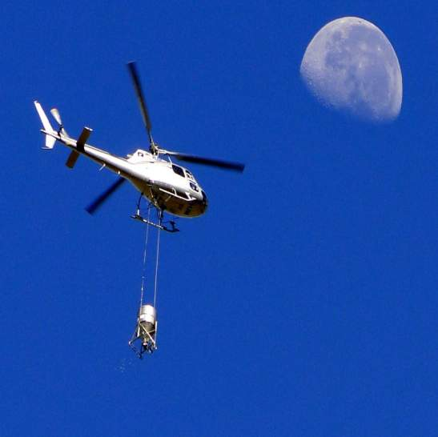
Science and the public
Why do people have different views of the same problem?
Why do we do science?
Graham Nugent

Slide 5
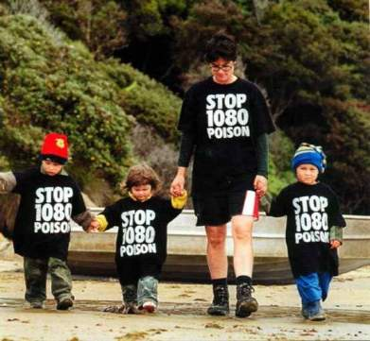
Issue Complexity
1080, or aerial application, or all toxins
Deer hunters: animal welfare, non-target species
Fur harvesters: absence of possums but blame 1080
Chemophobes, water, air, soil

Slide 6
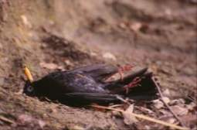
Ecological Complexity
Control strategies – thresholds
Individual vs population effects

Slide 7
Behaviour complexity
Skeptics: If you provide facts to counter their position they will often change
Denialists: Facts don’t change their beliefs

Slide 8
Denialists
Allege there is a conspiracy.
Use fake experts to support your story.
Cherry-pick the evidence.
Carry on trotting out supportive evidence even after it has been discredited.
Create impossible standards for your opponents. Existing evidence is not good enough and demand more.
If your opponent comes up with evidence you have demanded, move the goalposts.
Notes:
1. Conspiracy ACP owned by government
2. 5-minute bird counts (rent a scientist)
3. 1080 in water OK but what about endocrine disrupters

Slide 9
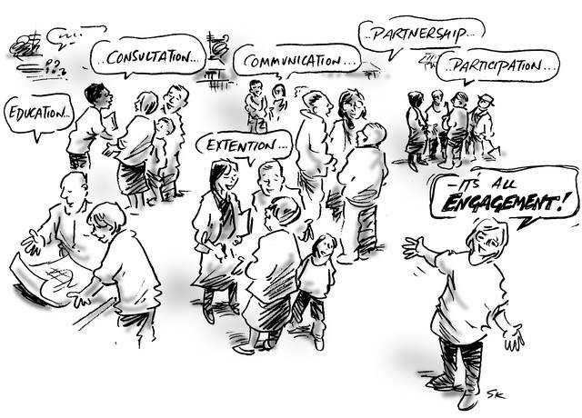
Consultation

Slide 10
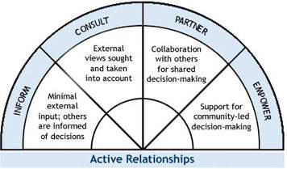
A central government perspective
Appreciative Inquiry
Change Lab using the U-Process
Charette
Citizens' Juries
Consensus Conference
Deliberative Method
Future Search
Graphic Facilitation
Open Agenda Conferences
Open House
Open Space Technology
Participatory Appraisal
Roadshows
Sustained Dialogue
World Cafe
Notes:
Mediated modelling

Slide 11
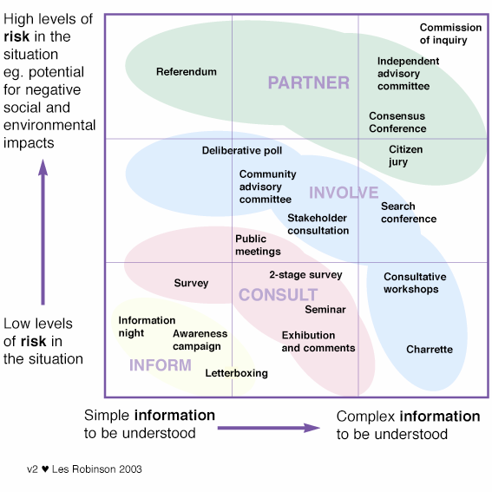
Notes:
Some public feel disenfranchised

Slide 12
How do we start?
Two case studies:
Trace changes in comprehension/opposition and levels of discourse around planning
Create visibility of project through social media
Where Possible places?
Who Possible communities?
What Decision(s) to get involved with?
How Techniques to use?

Slide 13
Possible Places
Waipoua: Little 1080 use but by-kill a concern
Wanganui: Possum fur/employment/anti-1080
Karamea/Kumara: Strong anti-1080 lobby
Coromandel: Strong anti-1080 lobby

Slide 14
Possible community
What is a community ?
Scale?
Participants?
Notes:
Participants include agency stakeholders (e.g. Fed Farmers)
Community of interest/issue or Community of place

Slide 15
Possible constraints
Decision makers have accountabilities:
Legal
Budgetary
Methodological
Time

Slide 16
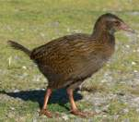
Media to Connect
Social media tools:
Facebook
Online deliberation space
Online discussion space (Forums)
Computer gaming (Pen Holland)
Wekapedia of information
?????
Notes:
Enable participants to connect and engage in conversations in different ways and to visualise more decision pathways and range of issues and options

Slide 17
Issues
How far could/would agencies move in sharing decision making?
What are the agency-specific pathways of decision making and their risk profiles?
What is the cost/benefit of participation versus not doing it?
How will results be linked with policy/practices

