Slide 1
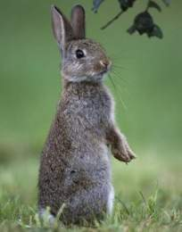
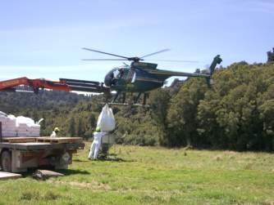
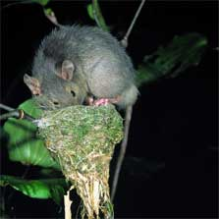
Control of Small Mammal Pests and Strategic Technologies for Multi-Species Pest Control

Slide 2
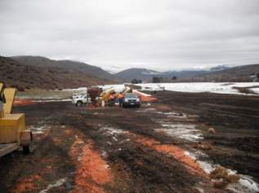
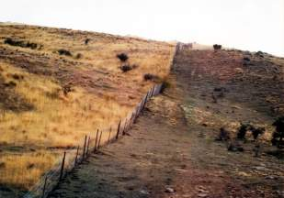
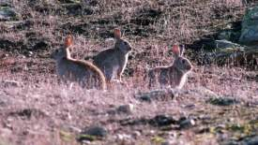
Control of Small Mammal Pests 3 years (finishes Sept 2012)
Objective 1
To integrate ecological, strategic, and operational knowledge for the improved management of rabbits.
Photos courtesy of Don Robson

Slide 3
Control of Small Mammal Pests
Obj 1: (Research strands)
Reducing control costs: What application of bait (amount and distribution) reliably puts all individuals at risk for least cost? (Latham, Warburton, Nugent, Fisher)
How can conventional control be best integrated with RHD to develop effective integrated pest management? (Smith, McGlinchy, Warburton)

Slide 4
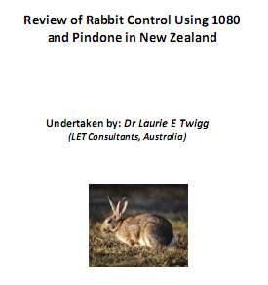
Control of Small Mammal Pests
Obj 1: Outputs
Web-based rabbit reference bibliography (http://Rabbits.landcareresearch.co.nz)
External review of science related to 1080 and pindone.

Slide 5
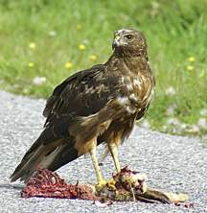
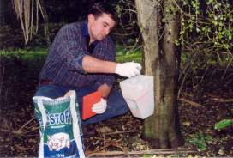
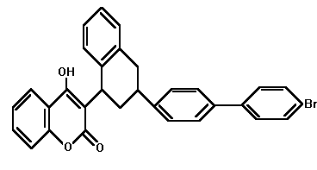
Control of Small Mammal Pests
Objective 2
To determine the potential environmental harm pest control poses through use of pesticides such as anticoagulants that can enter the food chain.

Slide 6
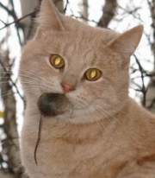
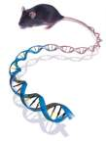
Control of Small Mammal Pests
Obj 2: (Research strands)
What are the residue profiles and pathways of pesticides (especially the anticoagulants) in wildlife species and livestock)? (Fisher)
What is the extent of genetic and behavioural resistance to anticoagulant toxins (rats and mice)? (Cowan, Hopkins)

Slide 7
Control of Small Mammal Pests
Collaborators and partners:
Regional Services (Otago Regional Council)
Marlborough District Council
MAF Rabbit coordination committee (Agencies and landowners)
National Possum Control Agencies (Best Practice updates and training)
Julius Kuhn Institute, Munster, Germany (Genetic resistance)

Slide 8
Strategic Technologies for MSPC 5 years (finishes Sept 2015)
Obj 1: Reducing the costs of aerial and ground-based control (possums and rats)
Obj 2: Reducing the adverse impacts of aerial and ground-based control (welfare, residues, non-targets)
Obj 3: Reducing community opposition to pest programmes

Slide 9
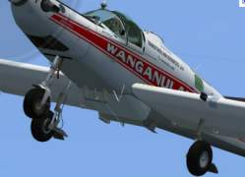
Objective 1 Reducing costs
Key Questions:
Can aerial control costs be reduced by re-engineering bait application by fixed-wing? (Warburton, Morgan, Nugent, Morriss)
Can ground control costs be reduced using novel technologies and improved understanding of interaction probabilities? (Warburton, Cowan, Brown, Gormley, Morgan)
Partners & collaborators
Rod Smillie , Josh Kemp (DOC)
Wanganui Aero work
Canterbury University Wireless Network Centre (MSc x 2)
Auckland University, School of Biol Sciences (PhD)
Clare Veltman (DOC)
KiwiCare Ltd

Slide 10
Objective 2 Reducing adverse impacts
Key Questions:
Can additives be used to minimise adverse impacts (welfare and residues) while maintaining or improving efficacy? (Fisher, Hopkins, Morgan)
Can repellents and changes in delivery mechanisms be used to effectively mitigate non-target impacts on native and introduced species? (Cowan, Nugent)
Partners & collaborators
AHB
Dr Katherine Horak, National Wildlife Research Centre (USA)
Pest Control Research
Animal Control Products
Dr Jens Jacob, Julius Kuhn Institute, Munster, Germany

Slide 11
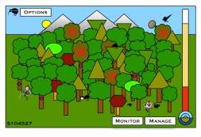
Objective 3 Reducing community opposition
Key Questions:
Can the mismatch between public concerns and current scientific consensus be effectively addressed through improved community dialogue? (Greenaway, Frame, Warburton, Cowan)
Can ecological games provide an effective medium for informing community participants of the economic and ecological consequences of their choices? (Holland)
Partners & collaborators
Clare Veltman, Harry Broad, Michelle Crowell (DOC)
John Deal, Nick Hancox (AHB)

