Slide 1
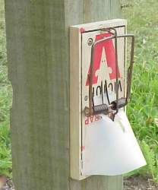
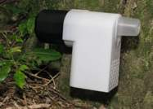
Are multiple-capture traps always better than single-capture ones?
Bruce Warburton and Andrew Gormley Landcare Research

Slide 2
MSI Strategic Technologies for MSPC Programme Objectives
Obj 1: Reducing the costs of aerial and ground- based control
Obj 2: Reducing the adverse impacts of aerial and ground-based control (welfare, residues, non-targets)
Obj 3: Reducing community opposition to pest programmes (increasing community participation in pest programmes)

Slide 3
Objective 1 Reducing the cost of ground control
Automatic traps for rats and stoats: Compare the cost-effectiveness of the newly developed automatic kill trap (Henry) with arrays of single-capture traps (e.g. Victor professional).
Wireless networks for remote detection and monitoring of traps.
Applications of long-life baits (e.g. Kiwicare gel bait) – includes possum behaviour around permanent and new bait stations

Slide 4
Multiple vs Single Capture Traps
Two stage approach:
Model control efficiency to determine optimal trap combinations and costs
Field test model predictions and obtain empirical data for critical parameters

Slide 5
Spatial Model
G(0) = Probability of a capture at the centre of the home range over one night
σ = measure of home range size (2.45 σ includes 95% of range)
Species | G(0) | Sigma
Possum | 0.05 | 63
Stoat | 0.05 | 400
Rat | 0.05 | 30

Slide 6
Inputs...1
Species | Densities | Trap spacing
Possums | 0.5-3.0/ha | 50 x 100
Stoats | 0.02-0.12/ha | 200 x 800
Rats | 1-11/ha | 25 x 100

Slide 7
Inputs...2
Trap type | Cost | Set up times (min) | Reset times (min)
Henry | $150 | 5 | 3
Sentinel | $28 | 5 | 2
Leghold | $12 | 3 | 2
Victor rat trap | $7.50 | 4 | 2
DOC 150 | $90 | 3 | 3
Time per 100m between traps = 6min
Cost/day $350

Slide 8
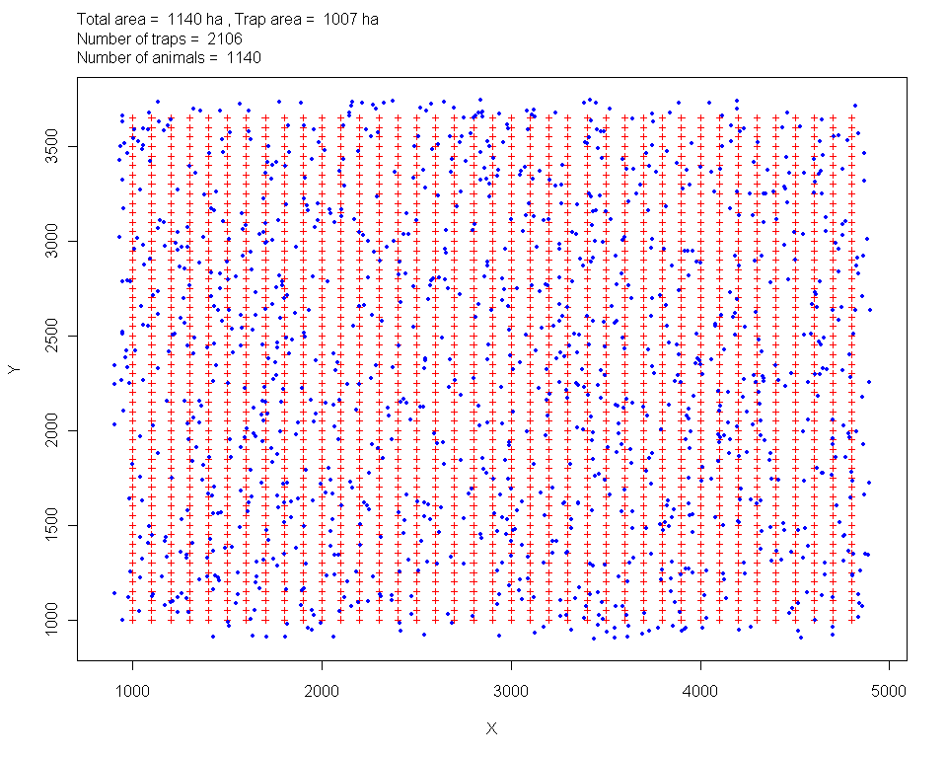

Slide 9
Assumptions
G(0) was the same for all trap types
Long-life bait available for all traps
Populations were closed (no immigration or breeding)

Slide 10
Results – Possums...1
Potential captures per site = 1

Slide 11
Results – Possums...2
Potential captures per site = 2

Slide 12
Results – Possums...3

Slide 13
Results – Stoat...1
Potential captures per site = 1

Slide 14
Results – Stoat...2
Potential captures per site = 3

Slide 15
Results – Stoat...3

Slide 16
Results – Rat...1

Slide 17
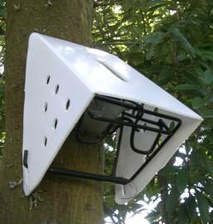
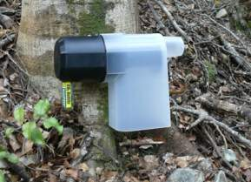
Costs – Possums

Slide 18
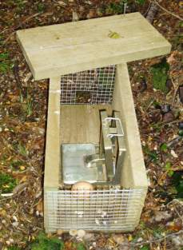
Costs – Stoats

Slide 19
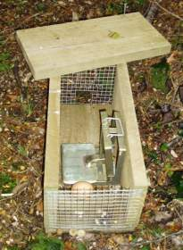
Costs – Rats

Slide 20
Conclusions
For possums and stoats, three traps/site is maximum needed
For rats, six traps/site is maximum needed
Additional capture capacity is redundant
For possums, three Sentinel traps set at a site is more cost-effective than the Henry
For stoats and rats Henry more cost-effective than DOC 200, but not Victor snap-back

