Slide 1
The low down and dirty of what introducing dung beetles can do for New Zealand
Shaun Forgie
LCR science provider for the Dung Beetle Release Strategy Group (DBRSG)

Slide 2
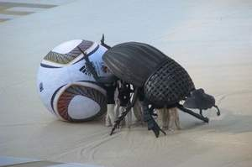
~ 8,000 species worldwide

Slide 3
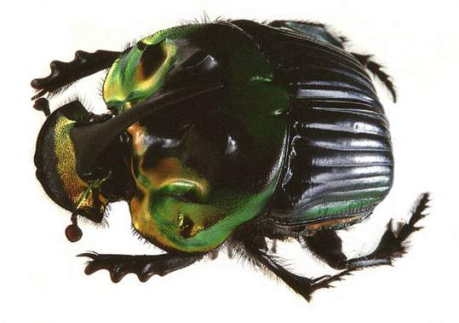
Shovel-shaped head for bull-dozing.
Front legs with teeth for digging.

Slide 4
Three ‘types of dung beetle’

Slide 5
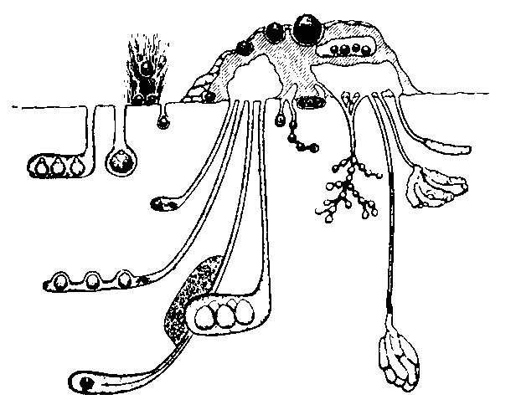
Rollers
(10min - 24hrs)
Dwellers
(several weeks)
90cm
Fast-burying tunnelers
(6 -24hrs)
Slow-burying tunnelers
(up to 6 weeks)

Slide 6
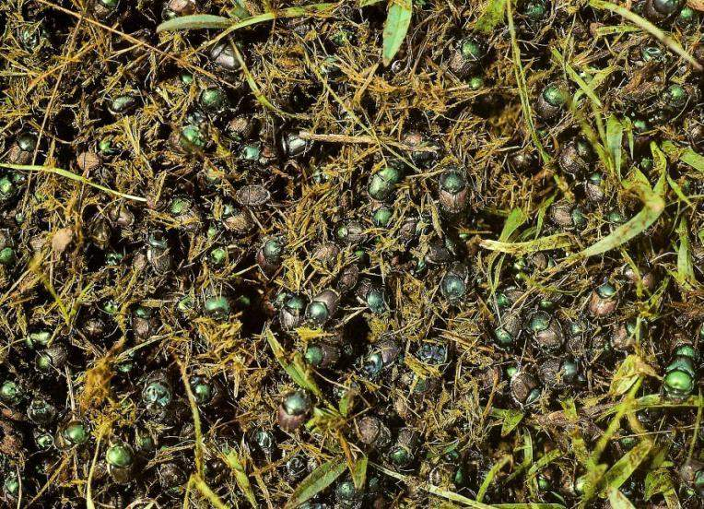
Tunnelers are:
by far the most abundant

Slide 7
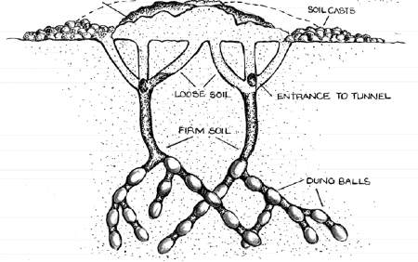
Tunnelers are:
by far the most abundant
responsible for the most dung buried

Slide 8
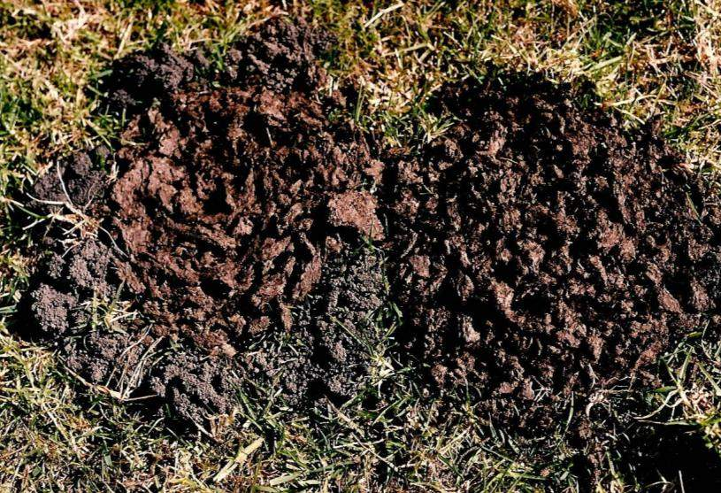

Slide 9
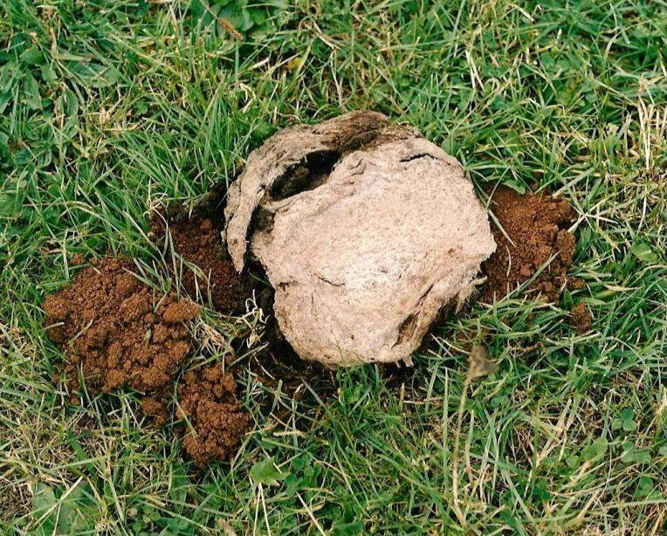

Slide 10
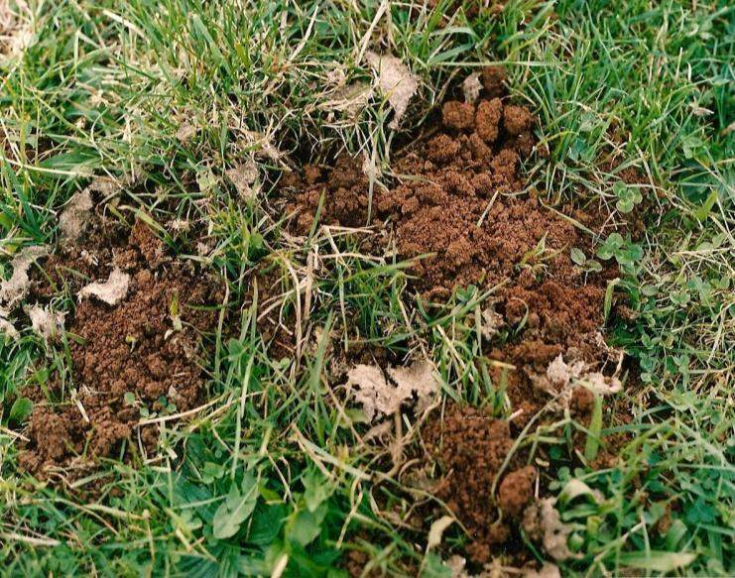

Slide 11
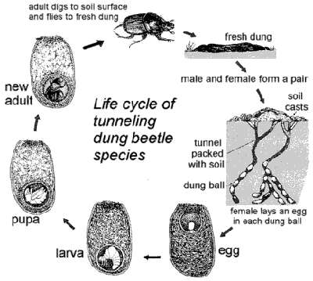

Slide 12
What dung beetles do we already have in NZ?

Slide 13
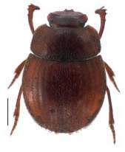
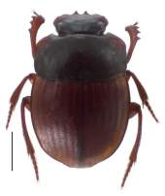
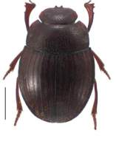
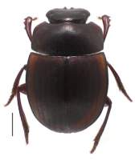
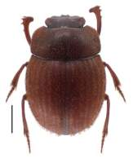
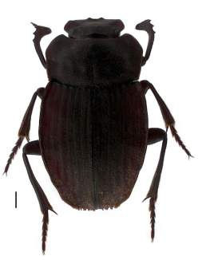
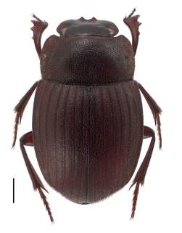
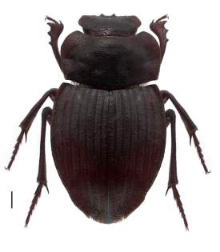
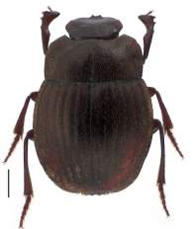
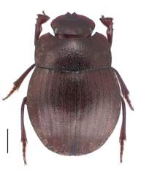
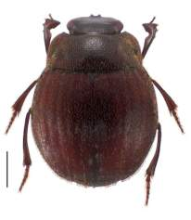
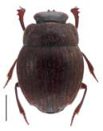
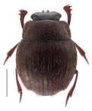
Native dung beetles

Slide 14
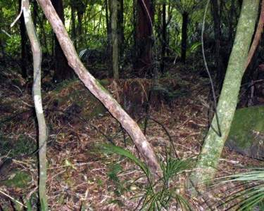
Native dung beetle habitat......

Slide 15
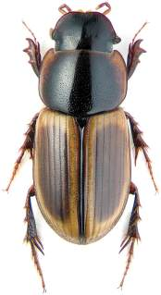
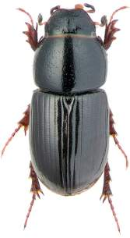
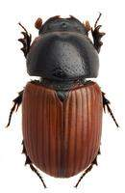
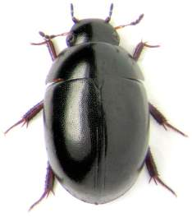
Exotic pastoral dung beetles already in NZ

Slide 16
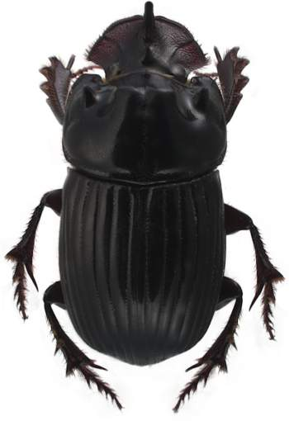
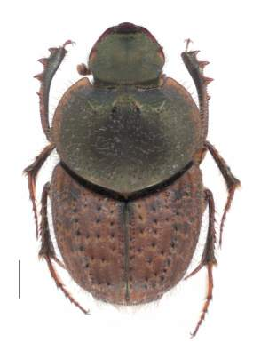
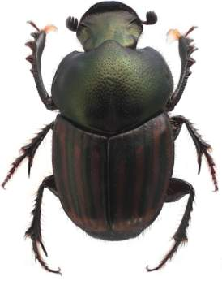
Exotic pastoral dung beetles already in NZ

Slide 17
Why do we want to introduce dung beetles?

Slide 18
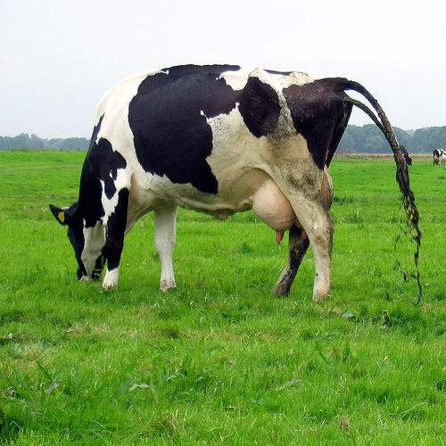
Most problems stem from ............
Intensive livestock
farming
Excess poo
Compaction

Slide 19
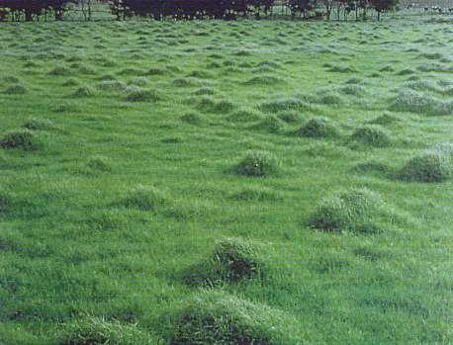
Intensive livestock farming promotes
forage fouling
9.6M head of cattle
~570-950 ha
dung/day
Animal stats: ex. MAF/livestock.
Haynes & Williams (1993)
rank growth (swards)
& zone of repugnance
an area 5x the size of
the dung itself
(Fincher,1981)
Notes:
Pasture fouling by dung can significantly reduce the area available for grazing and with it reduced pasture availability and reduced productivity.
Calculations for dung coverage area were provided by Haynes and Williams ( 1993) for cattle and sheep.
IN combining both, we estimate up to 15% of all pasture in New Zealand is rendered unusable by at any one time from these livestock alone. Each dung patch occupies its original coverage area for at least one week!
CLICK: We know there is a zone of repugnance because of live stock avoidance of an area far greater than the dung itself.
Fincher 1981 calculates this to be an area 5x the size of the dung itself.
Hence the practice of break-feeding to force livestock to feed around their own excrement and thereby graze all the pasture. While unproven, such practices can only contribute negatively to livestock wellbeing and health ( esp. Increase diseases uptake and rates of parasitic infection).
The loss associated with cattle pasture fouling and resulting rank growth is substantial. It is estimated that five cows will decrease the effective area of pasture by one acre over one year (Bornemissza, 1960). For a herd of 100 cattle this equates to a loss of 20 acres per year. An American economic analysis estimated that pasture fouling causes an annual loss of 7.63 kg of beef per head of cattle and places the cost of reduced pasture fouling at $122 million per annum (Losey & Vaughan, 2006).

Slide 20
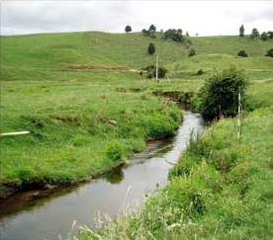
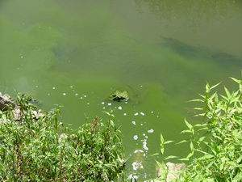
Intensive livestock farming promotes
surface runoff
dependent on slope, soil texture and soil
structure.
if rainfall (or irrigation) intensity is greater than infiltration rate of poorly managed soils water will accumulate on the surface and
run off will occur.
degradation in water quality
nitrogen and phosphorus
faecal coliforms
pathogens (Cryptosporidium, Giardia)
Notes:
Runoff is dependent on slope, soil texture and soil structure.
And, if rainfall (or irrigation) intensity is greater than infiltration rate of poorly managed soils water will accumulate on the surface and run off will occur.
CLICK: The quality of surface water influences not only the health of aquatic ecosystems, but also whether the water can safely be used for drinking, agriculture, or recreation.
There are a number of indicators used to measure water quality for example......
Nitrogen & Phosphorus
These are the main causes of the eutrophication or excessive growth in water ways: Sources include eroded soil material, treated and untreated sewage waste water, animal wastes, fertilisers and organic matter.
Faecal coliforms and pathogens
....are found in the faeces of warm-blooded animals and can infect waterways and drinking water and cross-infect different animal species. Faecal coliform presence in water is used as an indicator of faecal contamination.

Slide 21
benefits
Ecological and environmental benefits from the services provided by tunnelling dung beetles include.......
Improve soil fertility……….......…nutrients in dung
Improve soil structure……...........↓soil compaction
Improve soil biology….......….pasture earthworms
Increase available grazing area......…↓forage foul
Increase pasture productivity…..........↑grass yield
Improve water infiltration……............ via tunneling
Improve water quality……….........↓surface run-off
Reduce pests/disease.....................↓gut parasites
Sequester carbon……….......…….↓gas emissions
Notes:
1. Nutrient content in dung is variable being dependent on a number of factors particularly the animals diet. Williams and Haynes (1995) found that for every 100 kgs of dry cattle dung there was 0.82 kgs of phosphorus and 2.7 kgs of nitrogen. When considering the amount of available dung accumulating on pastoral surfaces, this represents a significant under-utilised resource of fertiliser. When dung remains on the soil surface approx. 80% nitrogen content of dung is denatured by bacteria and lost by volatilisation as ammonia or is washed into waterways with rain (irrigation). Several studies have shown that tunnelling beetles increase levels of plant nutrients in the subsoil at similar levels to typical application rates of solid fertiliser inputs.
2. The tunnel systems improve the physical structure of the soil by:
- increasing aeration
- reducing compaction
- bringing subsoils to the soil surface (bioturbation)
incorporating organic matter into the soil profile. It also improves water holding capacity ( water conservation in soils) reducing soil erosion
3. By burying dung, dung beetles:
- increase the amount of organic matter in the soil
- provide a food source for soil organisms such as earthworms
- stimulate microbial activity and nutrient cycling
Trials have shown that dung beetle activity is associated with increased numbers of
earthworms, and the depth at which they are found (Doube, 2008).
4. Dung beetles can make a substantial contribution to ensuring that forage fouling is kept to a minimum.
5. In an extensive review of published research, Nichols et al. (2008) found that “dung + beetles” resulted in significant increases in plant height, above ground biomass, grain production, protein levels and nitrogen content.
Tunnelling and improvements to the physical structure of soils have a “flow-on” effect which can include:
6. improved water infiltration reduces surface ponding and assists agricultural inputs such as lime and fertilisers to enter the upper soil profile and reduce the level of contaminants entering the waterways (Waterhouse 1974; Bormemissza 1976; Doube 2005b).
7. This leads to improved water quality (Doube 2008).
8. Nematodes. Many studies have shown significant reduction in numbers and/or reinfection rates of gut parasites ( e.g., Miller et al. (1961);Fincher (1973a, 1975); Waterhouse (1974); Bryan (1973, 1976); Fincher and Stewart (1979); Bergstrom (1983); Gronvold et al. (1992); Mathison and Ditrich (1999);Le Jambre (2009).
Flies. Several studies have shown significant reduction in numbers dung breeding pest flies e.g. 95% in Hawai’i (Bornemissza 1970); 88% in Australia (Ridsdill-Smith & Matthiessen, 1988). Phoretic macrochelid mites carried between dung pads also predatory on fly eggs etc ( Nichols et al 2008).
9. Removal of decomposing organic matter (dung) from the soil surface
- increase in soil carbon content through the burial of organic matter (dung)
- increased plant root production through improvements to soil physical, biological and
chemical properties ( Doube 2008).
While un-quantified, by rapidly manipulating freshly deposited dung, dung beetles will increase aerobic drier environment in dung pad thereby reducing anaerobic conditions necessary for methane production ( see Jarvis et al 1995; Holter 1996)

Slide 22
Economic benefits
LOSEY and VAUGHAN (2006). BioScience. Vol. 56 No. 4. Pages: 311-325. (www.biosciencemag.org).
Services provided by dung beetles are worth an estimated US$380 million/yr to the US economy
USA has almost 100 million cattle in production/yr
NZ has on average 9.6 million head of cattle in production per year
so, assuming equivalent benefits, dung beetles could be worth at least NZ$55 million per year to the NZ economy

Slide 23
ERMA process
Risks include:
Invasion of native habitats
Outcompeting native dung fauna
Altering native ecosystem processes
Spreading disease

Slide 24
ERMA process
Benefits
Risks
Significant
Negligible

Slide 25
ERMA granted permission for importation and full unconditional release of 11species of dung beetle for use in NZ pastureland

Slide 26
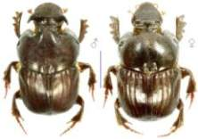
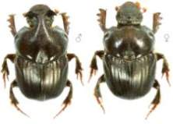
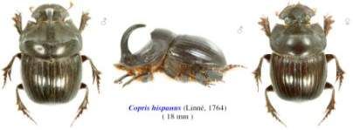
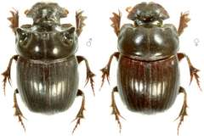
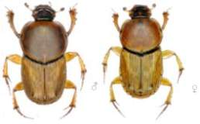
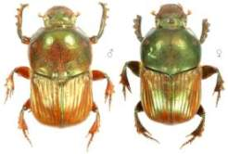
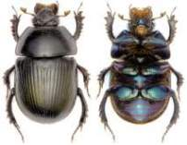
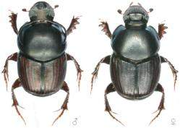
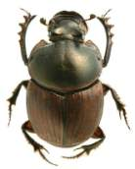
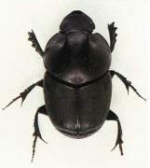
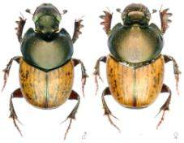
♂
♂
♀
Bubas bubalus
17mm
Bubas bison
16mm
Copris hispanus
18mm
♀
♂
Copris lunaris
18mm
Euoniticellus fulvus
10mm
Onitis alexis
20mm
Geotrupes spiniger
22mm
♂
♂
♂
♀
Onthophagus taurus
9mm
O. (Digitonthophagus) gazella
11mm
Onthophagus binodis
12mm
O. (Paleonthophagus) vacca
10mm

Slide 27
Selection Criteria
At least 11 species needed to control livestock dung 24-7, 365 days a year throughout NZ................
All species are habitat specific to open grasslands
All species evolved to feed specifically on the dung of herbivorous mammals (artiodactyles)
All species occupy differing but overlapping seasonal activity periods
Some species are day active,others night active or active only at dawn and dusk
Climatic suitability for nationional coverage

Slide 28
Who is introducing dung beetles to NZ?

Slide 29
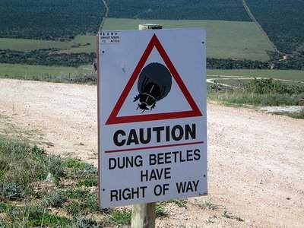
The Dung Beetle Release Strategy Group
This work was funded by MAF SFF, Landcare Research, DBRSG, DairyNZ, Rodney District Council + ARC (in part), Environment Southland, Rodney Economic Development Trust & Ngati Whatua

Slide 30
Scope of the NZ Dung Beetle Project
It is expected this project will last at least 10-15 years
Current DBRSG phase of project is funded for 3-4 years which involves:
ERMA process
Importation, quarantine and release at least 5 spp

Slide 31
Exotic species approved for release
♂
♂
♀
Bubas bubalus
17mm
Bubas bison
16mm
Copris hispanus
18mm
♀
♂
Copris lunaris
18mm
Euoniticellus fulvus
10mm
Onitis alexis
20mm
Geotrupes spiniger
22mm
♂
♂
♂
♀
Onthophagus taurus
9mm
O. (Digitonthophagus) gazella
11mm
Onthophagus binodis
12mm
O. (Paleonthophagus) vacca
10mm

Slide 32
Scope of the NZ Dung Beetle Project
It is expected this project will last at least 10-15 years
Current DBRSG phase of project is funded for 3-4 years which involves:
ERMA process
Importation, quarantine and release at least 5 spp
Post DBRSG phase, we plan:
Post release monitoring and research
Importation of remaining species
Mass rearing for nation wide releases
To achieve this we need to obtain government and/or non-government funding

Slide 33
Acknowldegements
MAF SFF,
Landcare Research
DBRSG
DairyNZ
Auckland City
Environment Southland
Rodney Economic Development Trust
Ngati Whatua
ERMA
Hugh Gourlay
Simon Fowler
Quentin Paynter
Lynley Hayes
Matt McGlone
Helen Parish

